Slide 1
ANT 3120 Physiology Exam 5
Combined Notes 14APR2022

Slide 2
Five Major Processes of the Digestive System
Ingestion
Mastication ( chewing ) of food and deglutition ( swallowing )
Motility
Propelling of contents through the digestive tract
Mixing of contents within the digestive tract
Digestion
Break down of food into their simplest forms ( nutrients )
Mechanical digestion
Physical break down
Mastication / Chewing
Mixing
Chemical Digestion
Break down of large molecules into small molecules
Carbohydrates into monosaccharides
Proteins into tripeptides , dipeptides , and amino acids
Lipids into fatty acids , monoglycerides , and cholesterol
Done by specific digestive secretions
Some foods are ingested in forms that do not require digestion
Already in their simplest forms ( eg , vitamins , minerals , simple sugars , water )
Absorption
Transport of nutrients to the circulatory system ( blood and lymph )
Allows nutrients to be utilized by the body
Elimination
Removal of undigested and unabsorbed material from the body

Slide 3
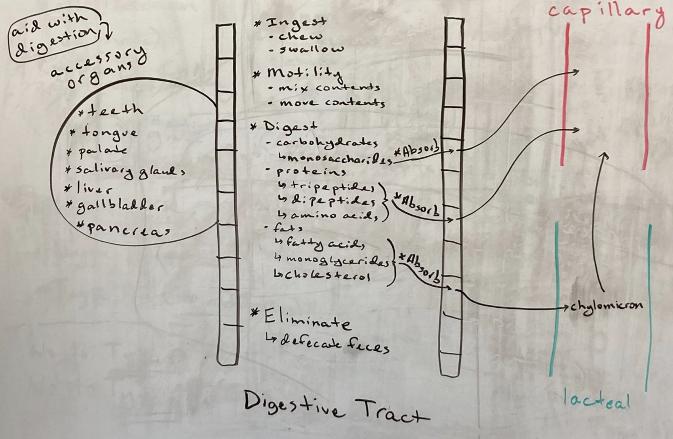
Five Major Processes of the Digestive System

Slide 4
Regulation of the Digestive System
Processes that regulate motility , digestion , absorption , and elimination
Nervous System
Hormones
Paracrines

Slide 5
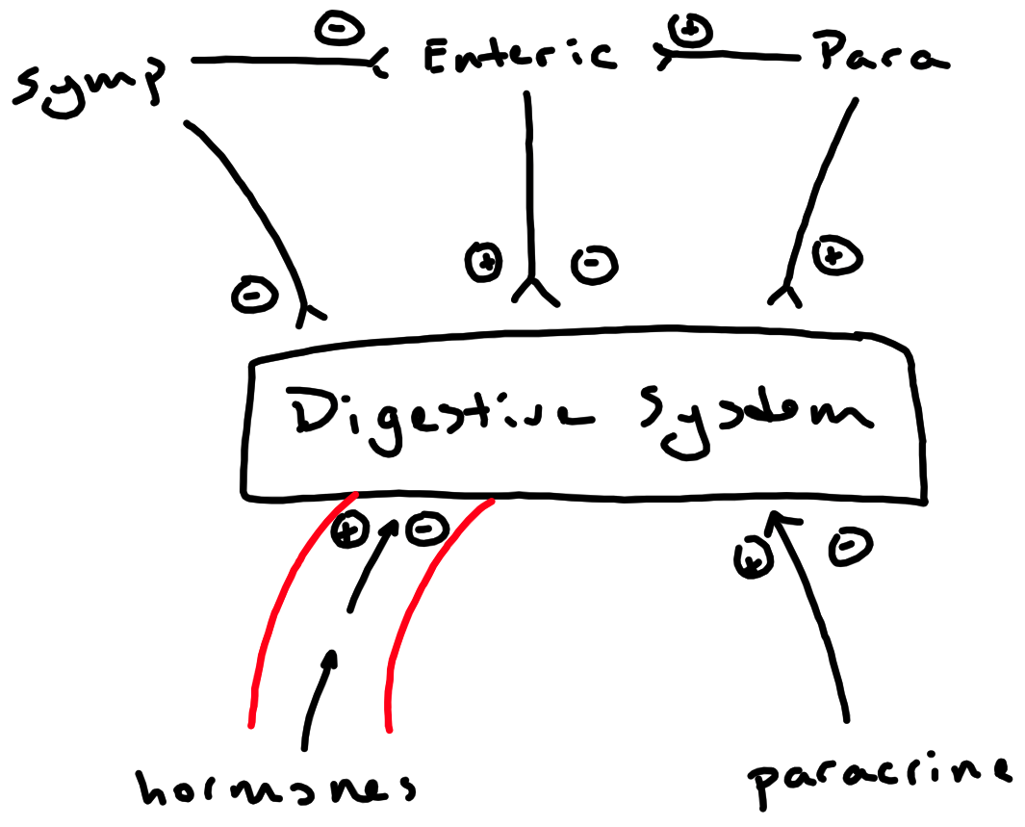

Slide 6
Regulation of the Digestive System – Autonomic Nervous System
Enteric Nervous System
Submucosal plexus and myenteric plexus
Influenced by the autonomic nervous system
Can operate autonomously
Functions to stimulate or inhibit the digestive system
Sympathetic
Functions to inhibit the digestive system
Parasympathetic
Functions to stimulate the digestive system

Slide 7
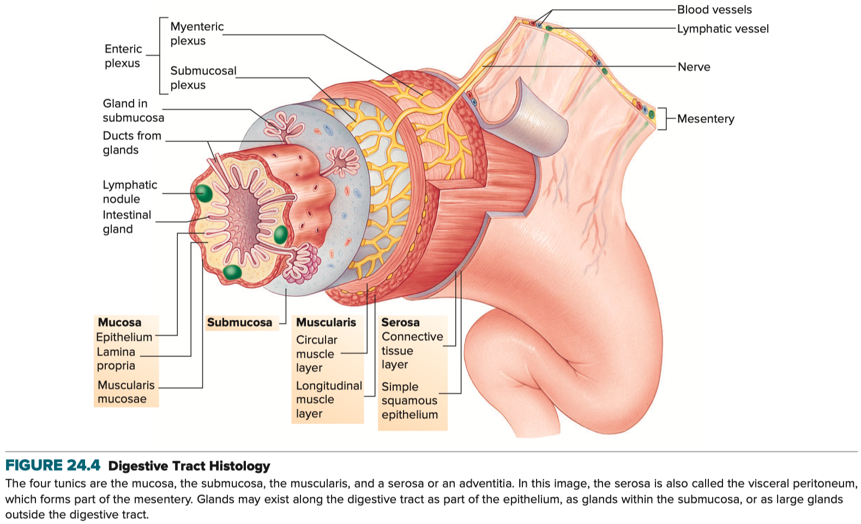
Walls of the Digestive Tract Consist of Four Layers

Slide 8
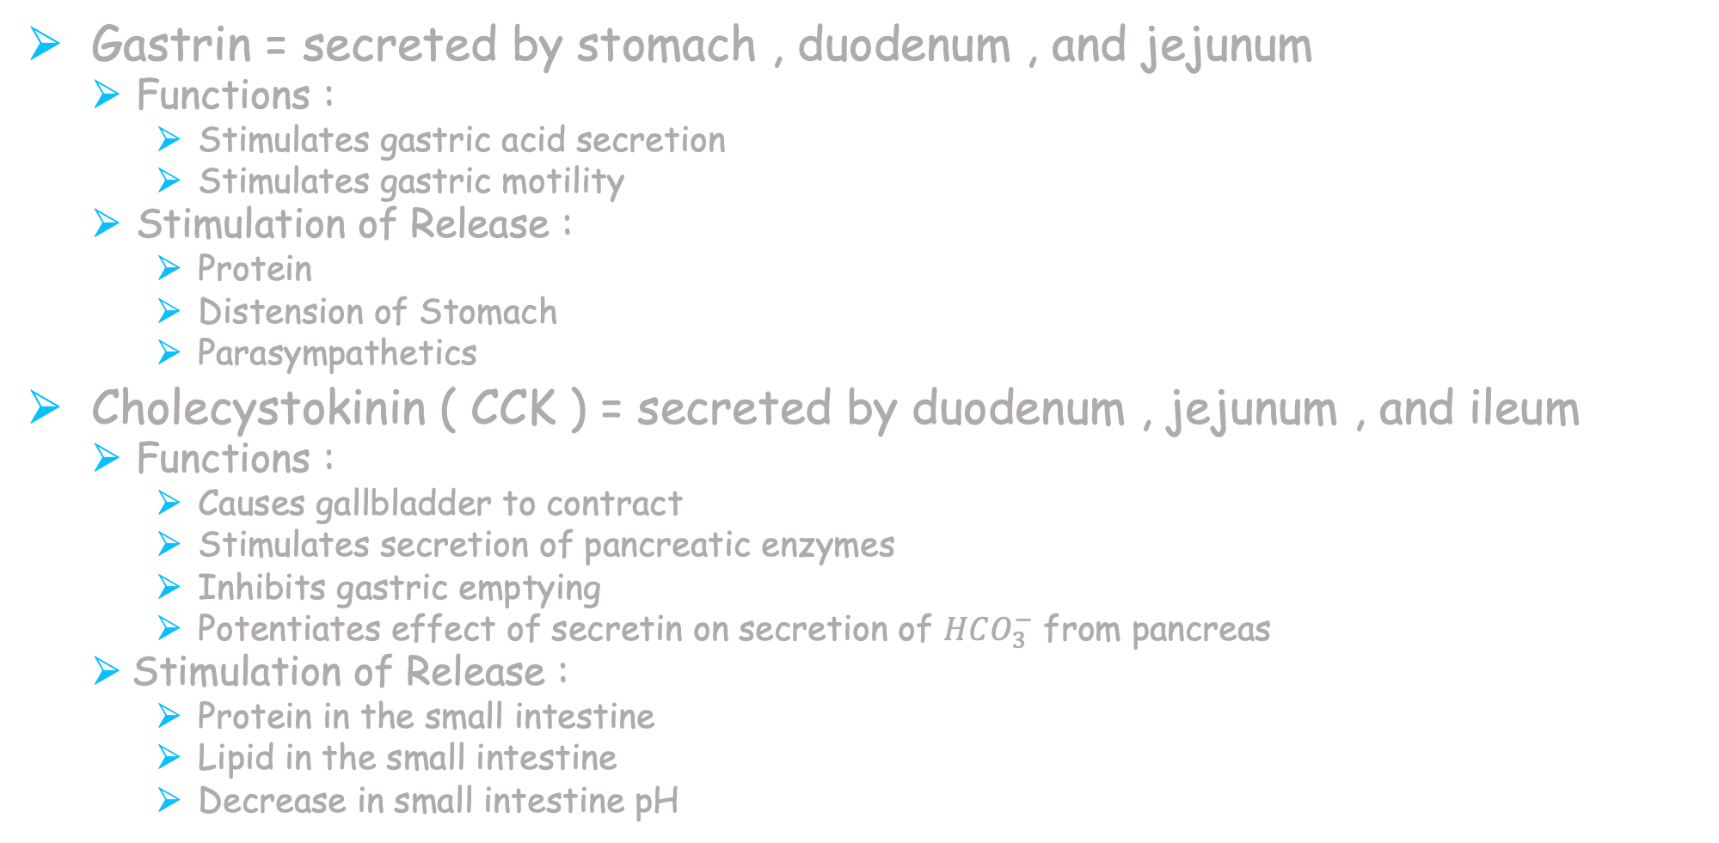
Regulation of the Digestive System - Hormones
Gastrin = secreted by stomach , duodenum , and jejunum
Functions :
Stimulates gastric acid secretion
Stimulates gastric motility
Stimulation of Release :
Protein
Distension of Stomach
Parasympathetics
Cholecystokinin ( CCK ) = secreted by duodenum , jejunum , and ileum
Functions :
Causes gallbladder to contract
Stimulates secretion of pancreatic enzymes
Inhibits gastric emptying
Potentiates effect of secretin on secretion of $HCO_{3}^{−}$ from pancreas
Stimulation of Release :
Protein in the small intestine
Lipid in the small intestine
Decrease in small intestine pH

Slide 9
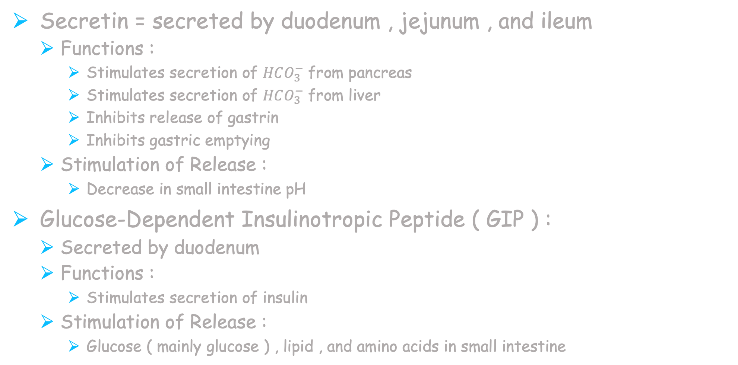
Regulation of the Digestive System - Hormones
Secretin = secreted by duodenum , jejunum , and ileum
Functions :
Stimulates secretion of $HCO_{3}^{−}$ from pancreas
Stimulates secretion of $HCO_{3}^{−}$ from liver
Inhibits release of gastrin
Inhibits gastric emptying
Stimulation of Release :
Decrease in small intestine pH
Glucose-Dependent Insulinotropic Peptide ( GIP ) :
Secreted by duodenum
Functions :
Stimulates secretion of insulin
Stimulation of Release :
Glucose ( mainly glucose ) , lipid , and amino acids in small intestine

Slide 10
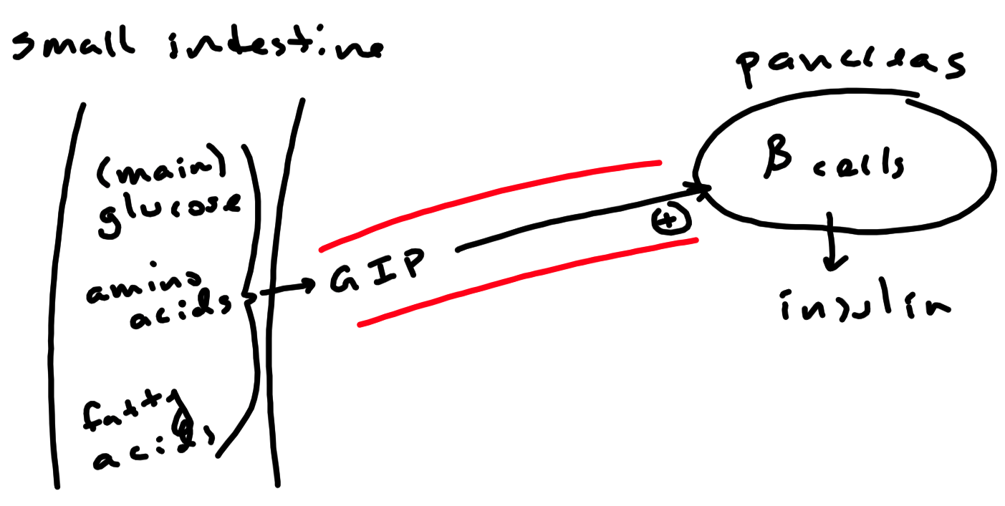

Slide 11
Regulation of the Digestive System - Paracrines
Somatostatin = secreted by the stomach
Function = Inhibits gastric acid secretion
Stimulation of Release = decreased gastric pH
Histamine = secreted by stomach
Function = Stimulates gastric acid secretion
Stimulation of Release = Parasympathetics

Slide 12
Ingestion
Mastication / Chewing
Deglutition / Swallowing

Slide 13
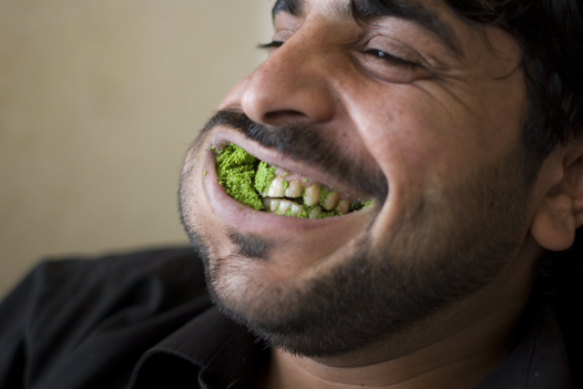
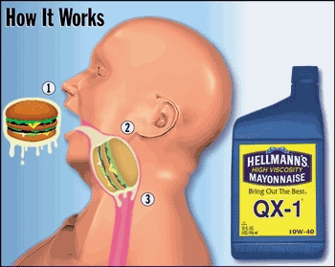
Mastication / Chewing
Function :
Mechanical Digestion
Reduces size of food
Mixes food with saliva to form bolus
Semi-solid mass that is swallowed

Slide 14
Deglutition / Swallowing
Divided into 3 Phases
Oral Phase ( voluntary )
Tongue pushes bolus to back of throat ( oropharynx )
Pharyngeal Phase ( involuntary )
Initiated by bolus in oropharynx
Causes activation of swallowing center in medulla
Motor output from swallowing center
Causes soft palate to pull upward
Keeps bolus from entering nasopharynx
Causes epiglottis to cover the glottis
Keeps bolus from entering the larynx
Causes upper esophageal sphincter ( UES ) to relax
Bolus passes from laryngopharynx to esophagus
Breathing is inhibited during the pharyngeal phase
Esophageal Phase ( involuntary )
Initiated by bolus in the esophagus
Once bolus passes into esophagus , UES closes
Prevents reflux of bolus into pharynx
Bolus travels the length of the esophagus
Bolus enters stomach by passing through lower esophageal sphincter

Slide 15
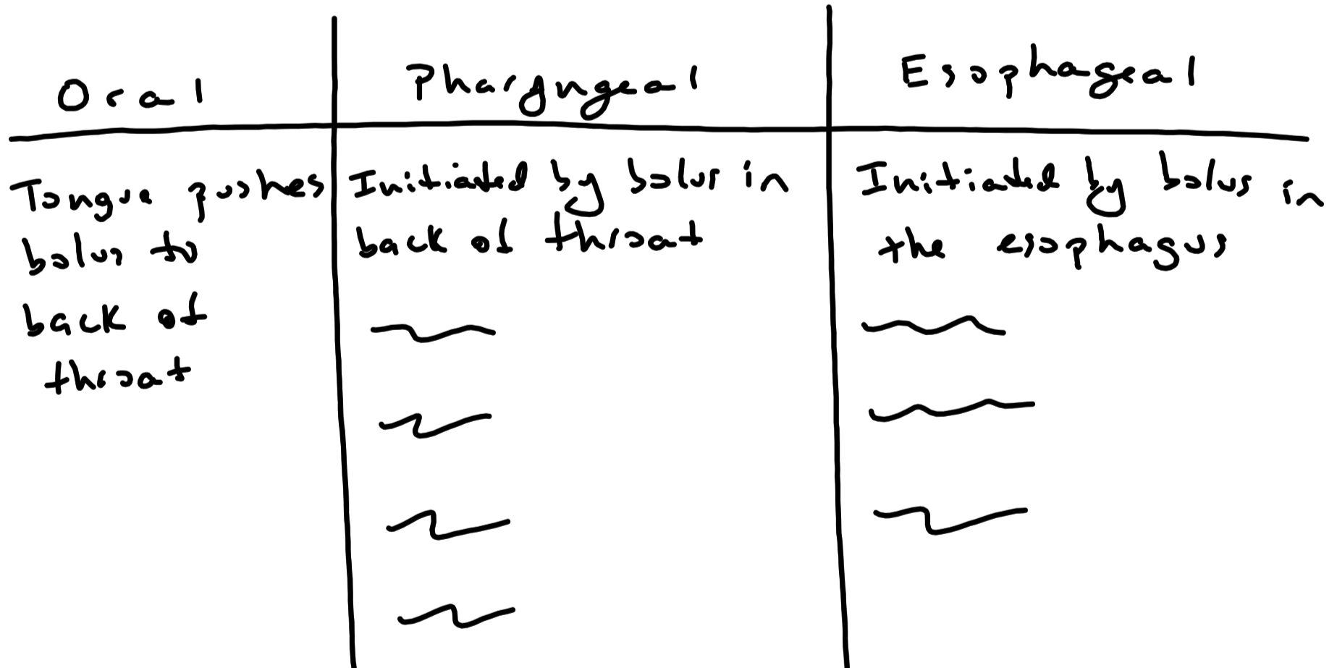

Slide 16
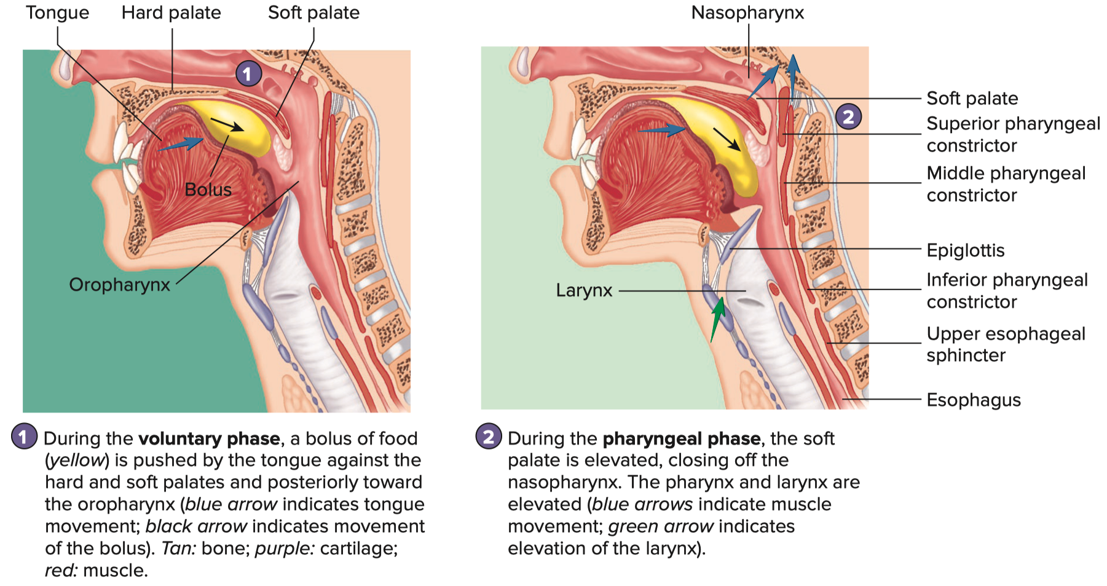
Oral and Pharyngeal Phases

Slide 17
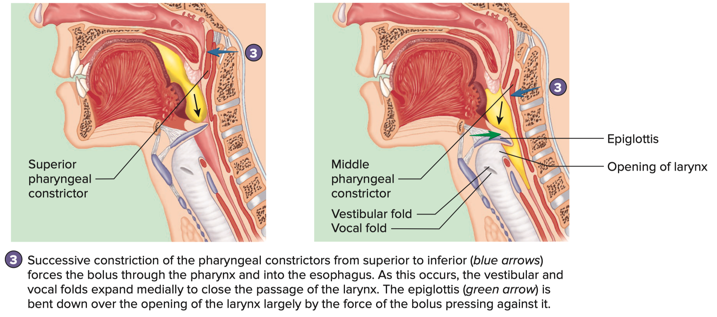
Oral and Pharyngeal Phases

Slide 18
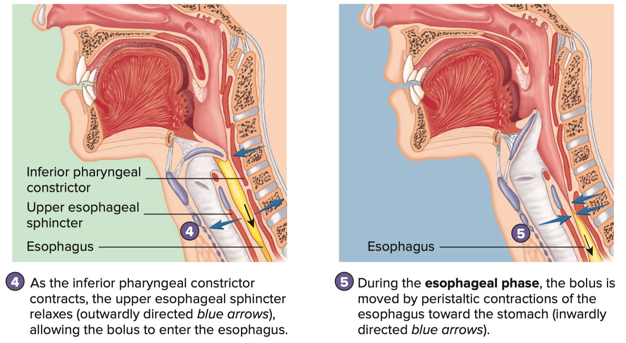
Esophageal Phase

Slide 19
Motility
Peristalsis
Wavelike contractions of the digestive tract that propel contents
Circular layer contracts behind and relaxes in front of contents
Longitudinal layer relaxes behind and contracts in front of contents
Mixing
Series of contractions and relaxations of circular layer that mix the contents
Sphincters
Ring of smooth muscle
Exception is UES and external anal sphincter , are a ring of skeletal muscle
Exhibit sustained contractility , which keeps them closed
When relaxed , allows for the passage of digestive tract contents
Sphincters are relaxed by peristalsis
Sphincter tone influences motility
Higher tone decreases motility
Lower tone increases motility

Slide 20
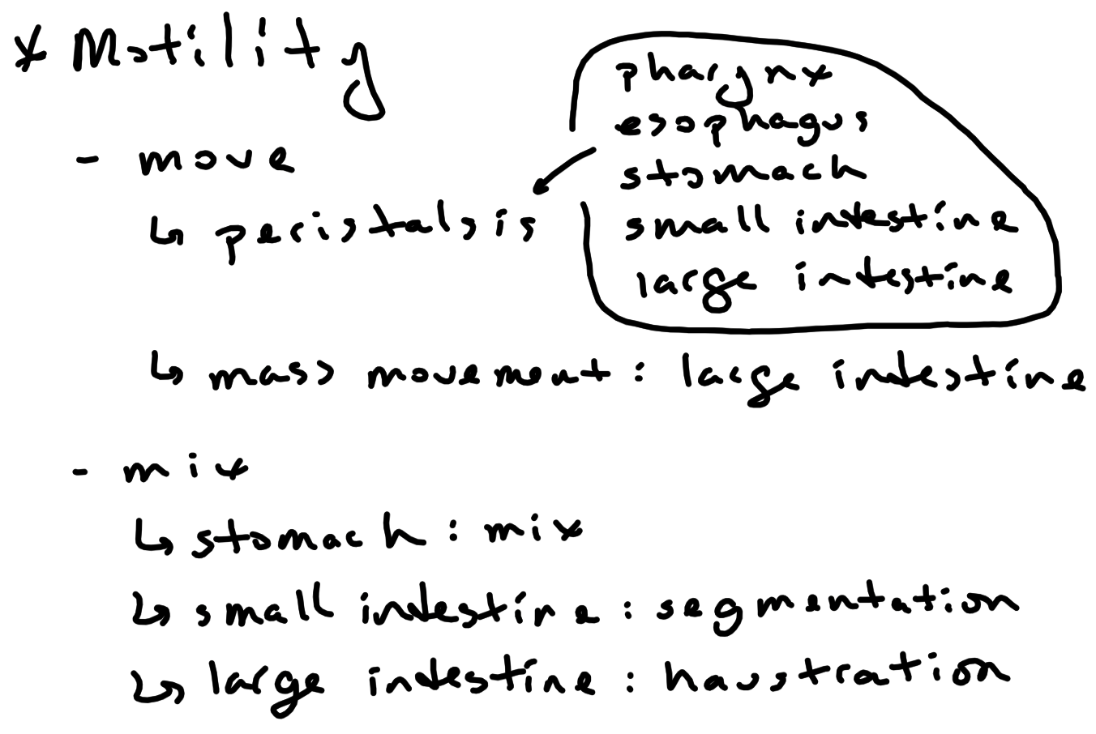

Slide 21
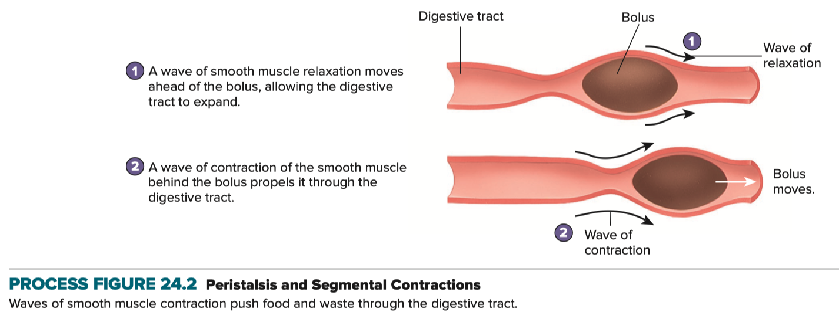
Motility

Slide 22
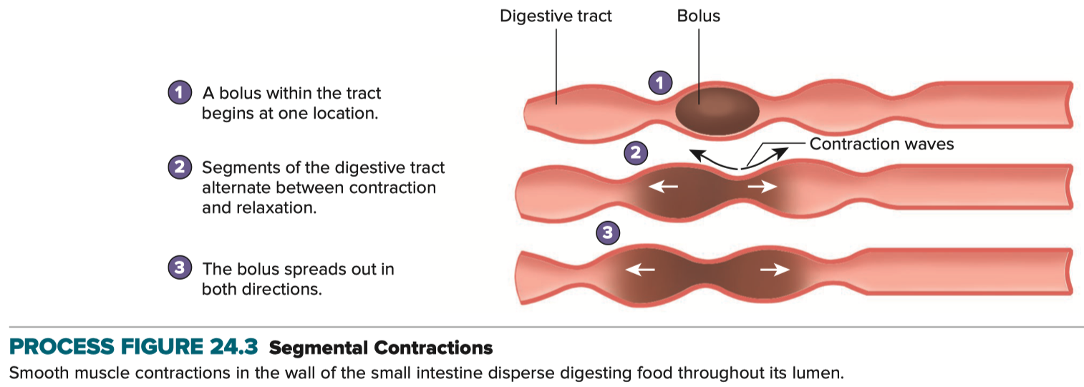
Motility

Slide 23
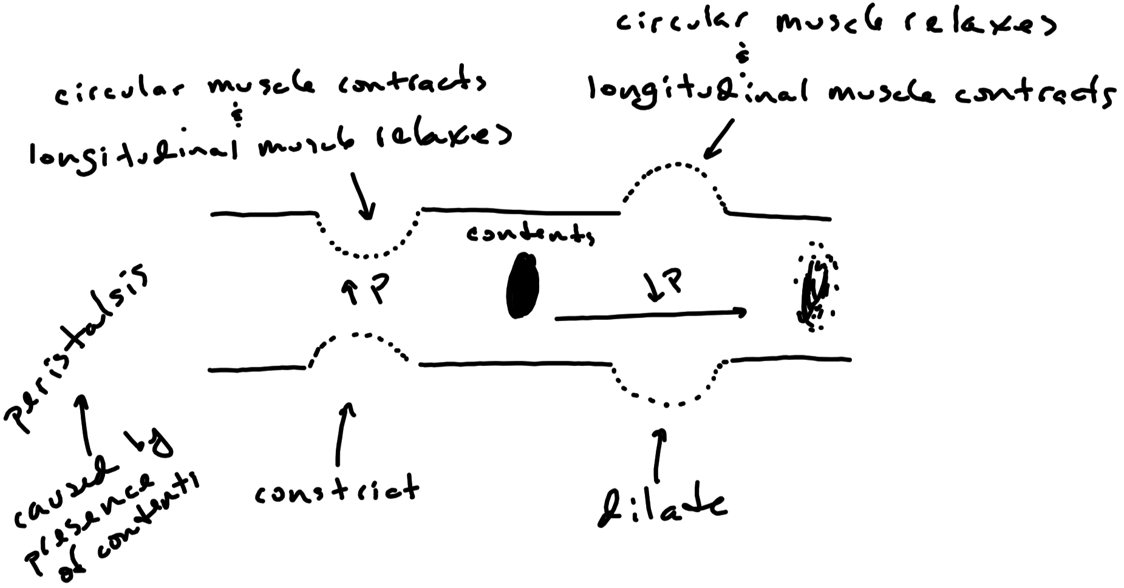

Slide 24
Esophageal Motility
Peristalsis propels bolus toward the stomach during esophageal phase of swallowing
Bolus takes approximately 3 to 10 seconds to move through the esophagus
Peristalsis causes relaxation of lower esophageal sphincter ( LES )
Allows contents of esophagus to empty into the stomach
Should be closed in the absence of esophageal peristalsis
Prevents contents of stomach from refluxing into esophagus
Gastroesophageal Reflux Disease ( GERD )

Slide 25
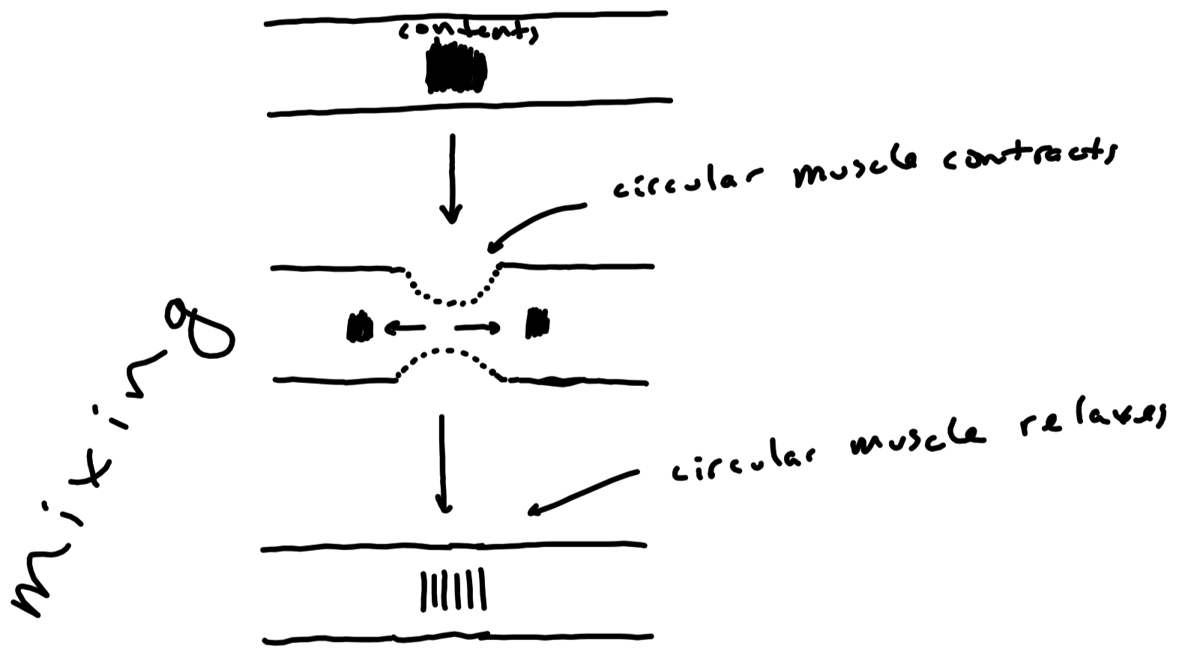

Slide 26
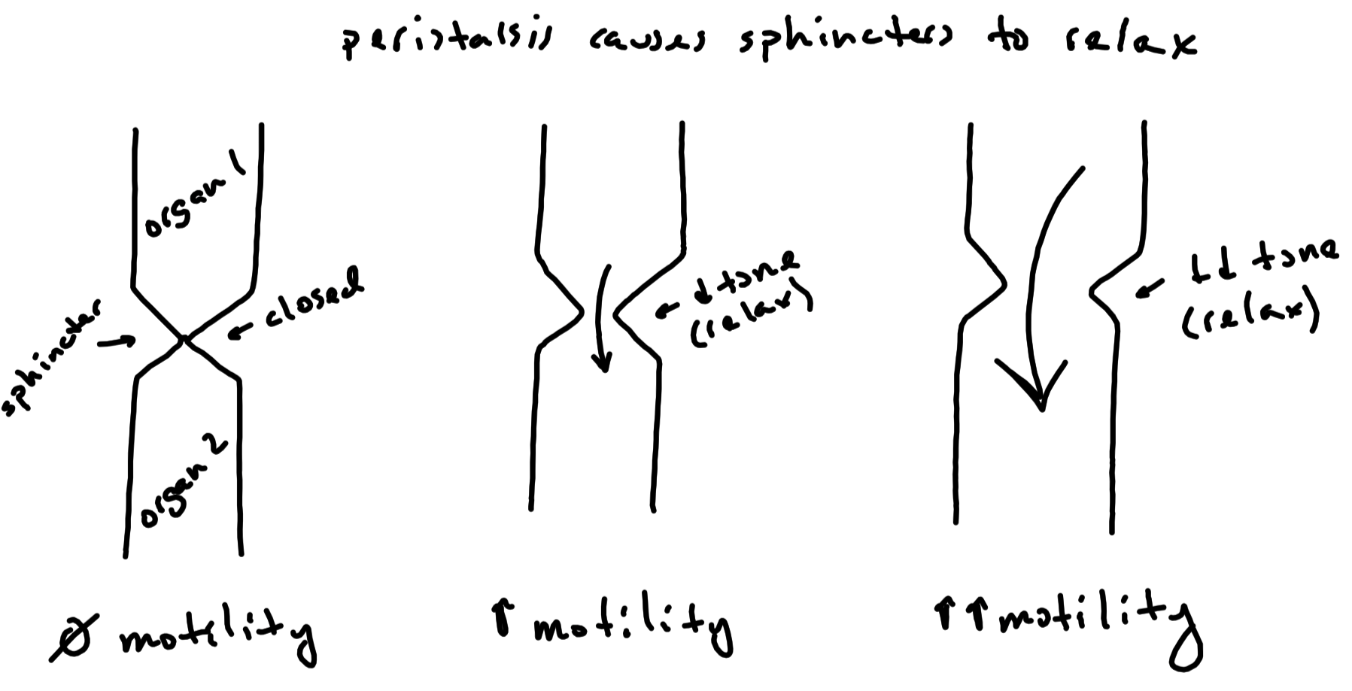

Slide 27
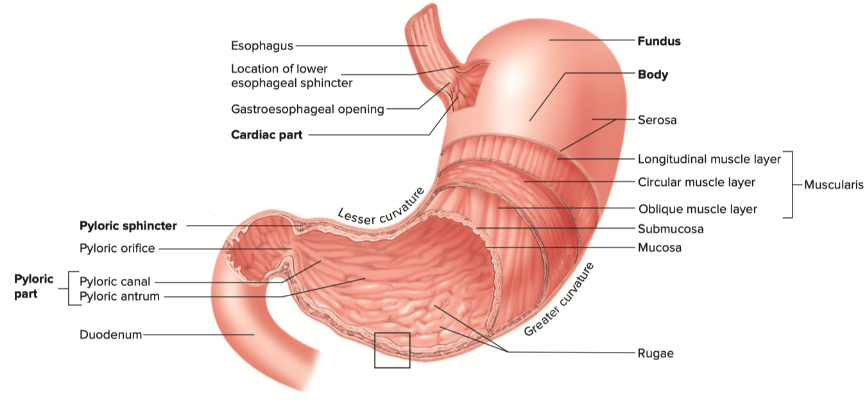
Stomach Motility
Main function is mixing
Mixes bolus with gastric juices to form chyme

Slide 28
Stomach Motility
Gastric emptying via peristalsis
Each peristaltic wave empties approximately 1% of stomach contents
Approximately three peristaltic waves per minute
Causes opening of pyloric sphincter , so contents empty into duodenum
Takes approximately 2 to 3 hours to empty a “normal” sized meal
Rate of emptying dependent on contents
Carbohydrates empty the fastest
Lipids empty the slowest

Slide 29
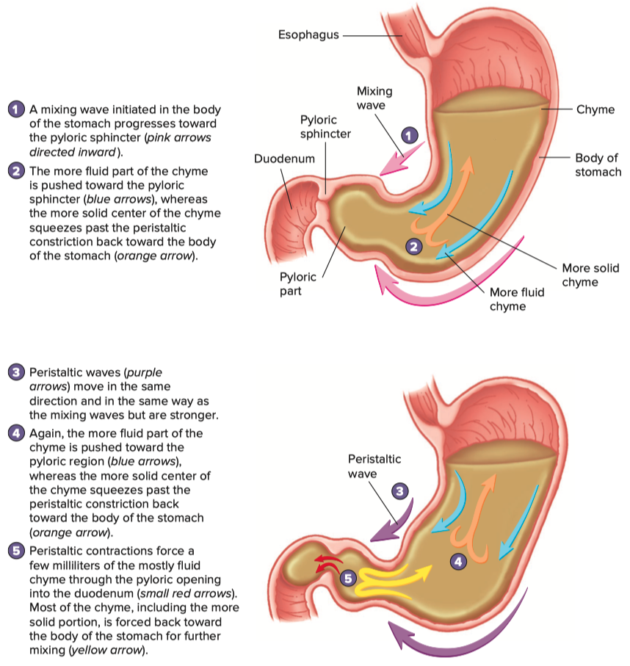
Stomach Motility
Stimulation of gastric emptying
Increased volume of contents in stomach
Increased fluidity of chyme in stomach
Inhibition of gastric emptying
Decreased fluidity of chyme in stomach
Lipids in duodenum ( most potent inhibitor )
Mediated by cholecystokinin
Digestion and absorption of lipids in small intestine is slow
Gives small intestine more time to digest and absorb lipid
Chyme below pH 2.0 in duodenum
Mediated by secretin and cholecystokinin
Gives small intestine more time to neutralize acid
Hypertonic or hypotonic contents in duodenum
Gives duodenum more time to make chyme isotonic

Slide 30
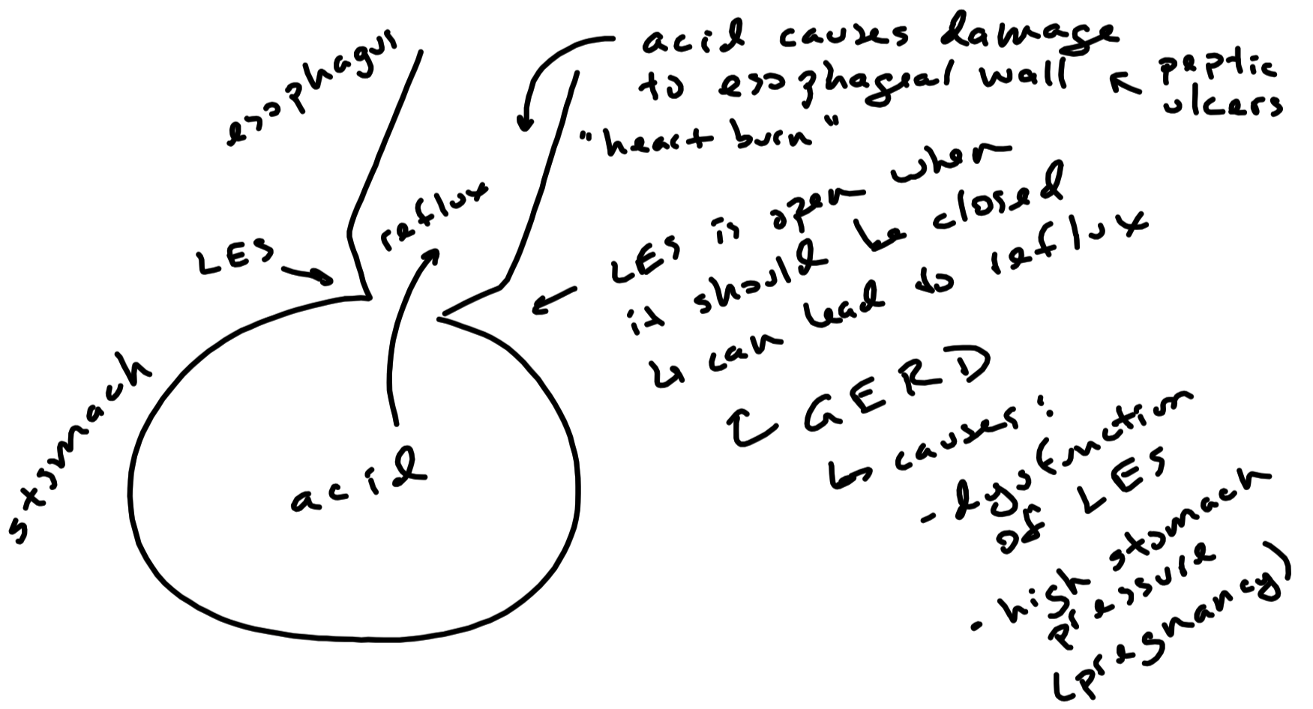

Slide 31
Small Intestine Motility
Segmentation / Mixing
Most prevalent movement of the small intestines
Peristalsis
Takes approximately 4 to 6 hours for chyme to move through small intestine
Stimulation of Motility
Distension ( by presence of emptied chyme from stomach ) of duodenum
Hypertonic or hypotonic chyme in duodenum
Low pH of chyme in duodenum
Protein digested contents in the duodenum

Slide 32
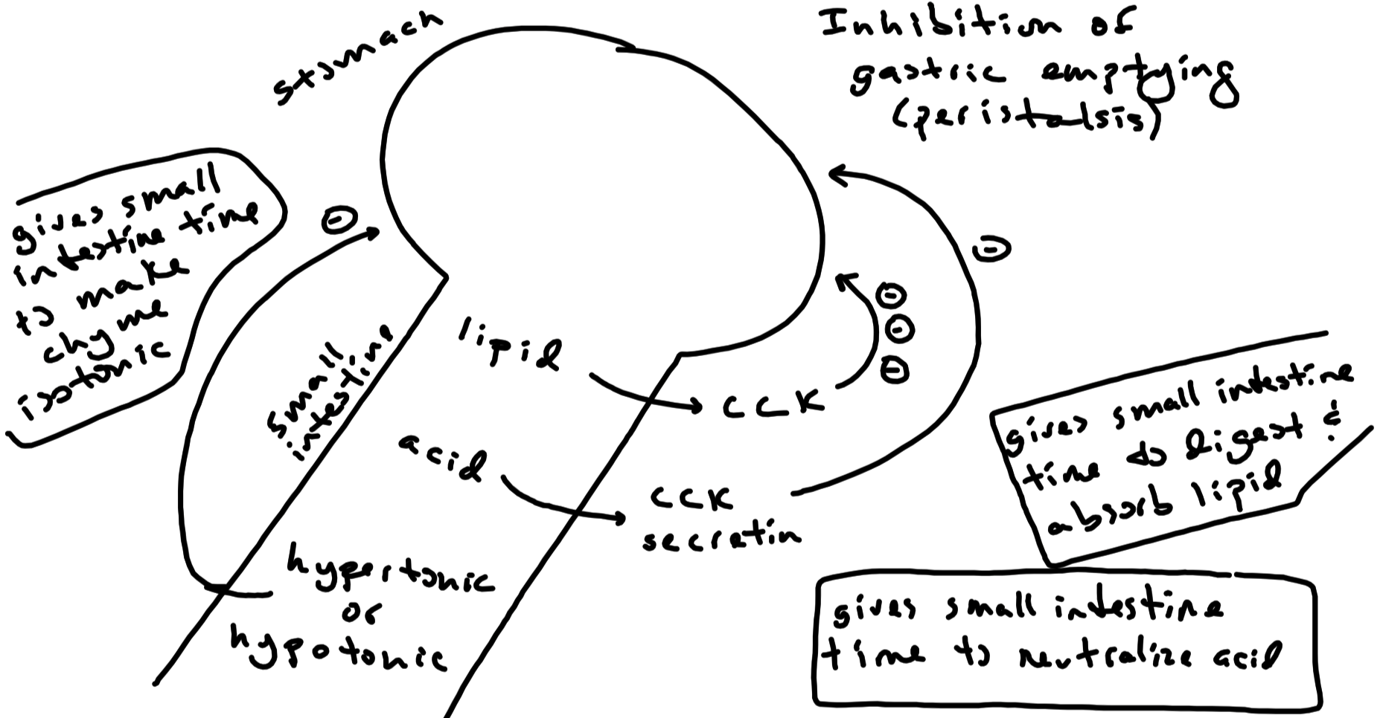

Slide 33
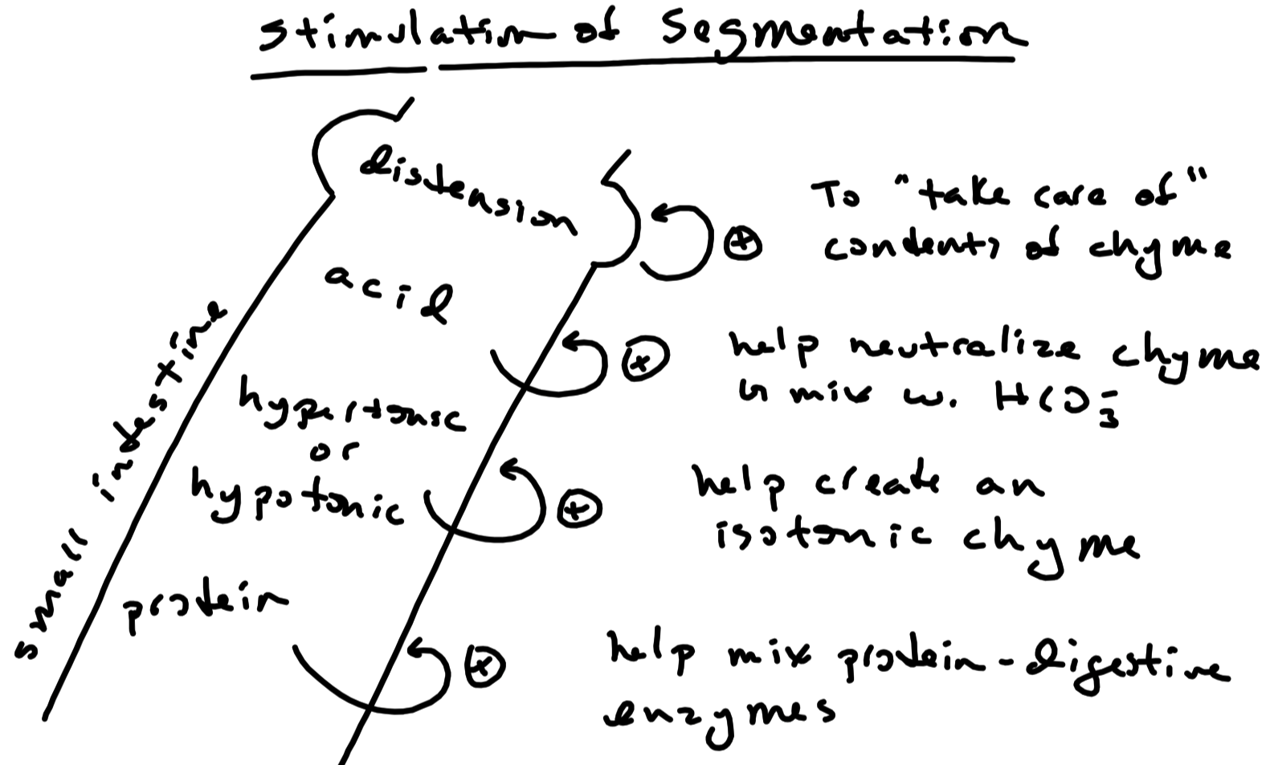

Slide 34
Large Intestine Motility
Haustration / Mixing of Contents
Aids in formation of feces
Water , undigested material , mucous , flora ( 30% of dry weight )
Brown due to bile pigments ( ie , bilirubin )
Peristalsis
Very little peristalsis ( occurs in the ascending colon )
Mass Movement ( not peristalsis )
Typically occurs a few times per day
Gastric Reflex :
Initiated by distension of stomach when food is present
Activates parasympathetic reflex that stimulates large intestine
Causes mass movement
Very slow compared to the rest of the digestive tract
Normally , 18 to 24 hours for material to pass through large intestine
Slow movement allows for the incubation of flora ( “good” bacteria )
Flora feed off of nutrients left in chyme
Flora produce vitamin K and certain B vitamins
Elimination
Rectosphincteric Reflex :
Initiated by distention of the rectum
Parasympathetics reflexively contract the rectal walls
Parasympathetics reflexively relax the internal anal sphincter
Voluntary relaxation of the external anal sphincter expels feces
Defecation : feces expelled ( not part of rectosphincteric reflex )
Voluntary contraction of abdominal muscles
Voluntary relaxation of external anal sphincter

Slide 35
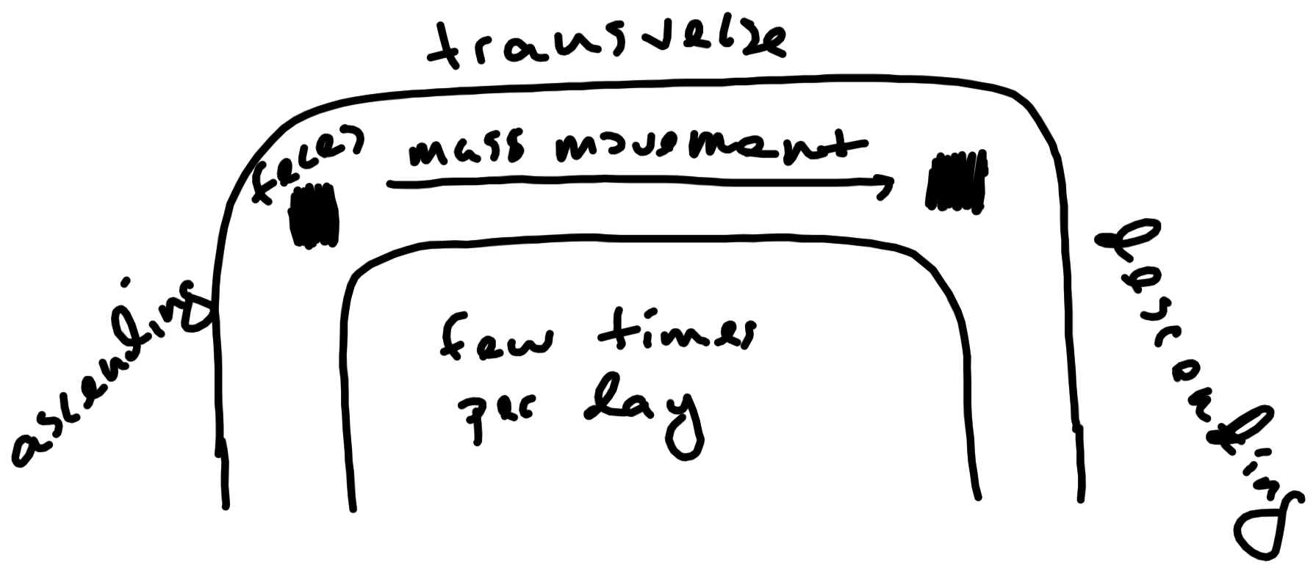

Slide 36
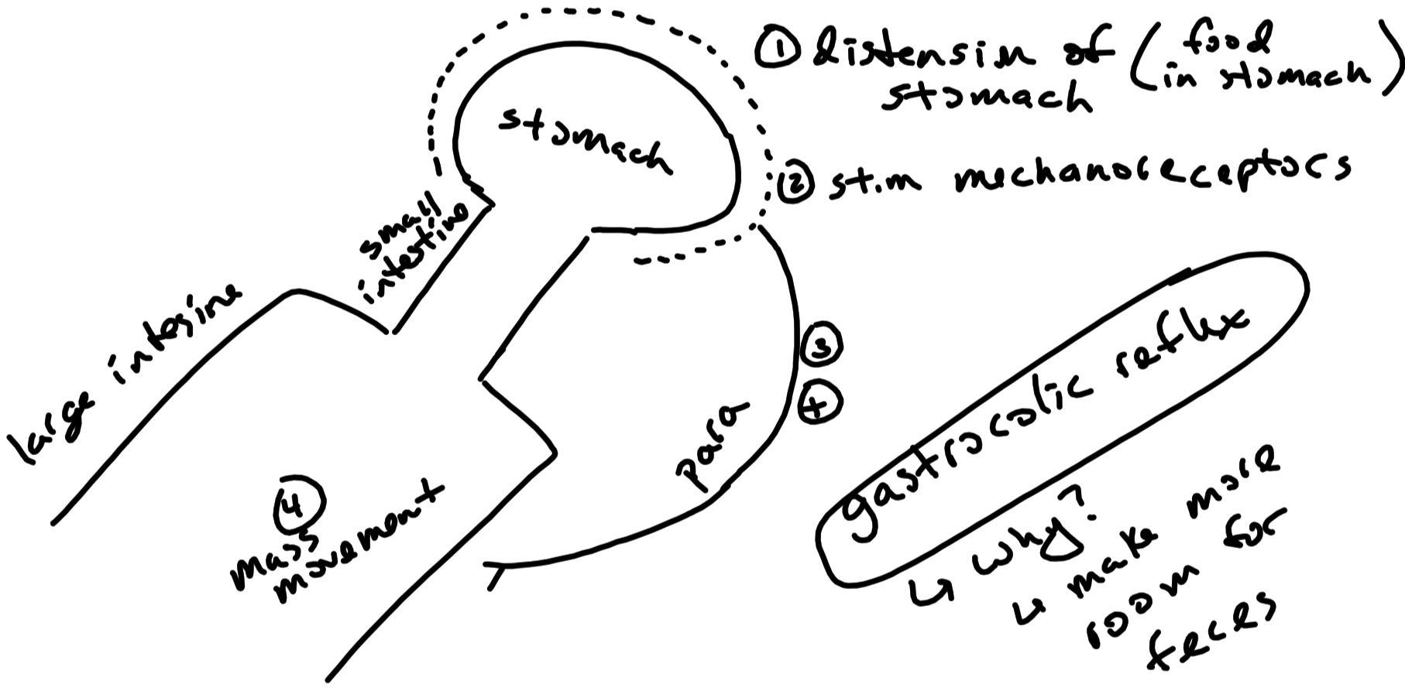

Slide 37
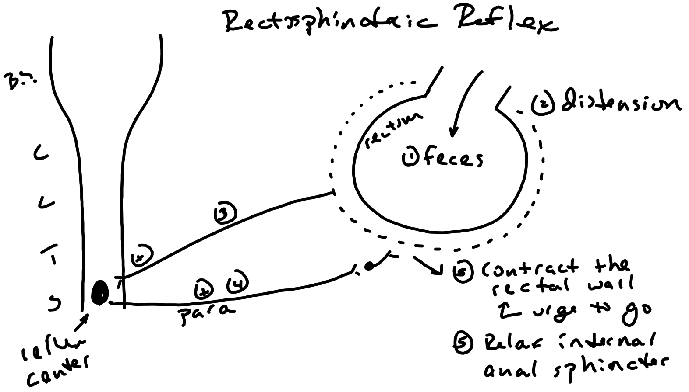

Slide 38
Oral Cavity
Teeth
Mechanically break down food
Tongue
Mechanically breaks down food
Presses food against the hard palate
Salivary Glands
Production of saliva ( 1 to 1.5 liters per day )
Aqueous component
Organic component

Slide 39
Saliva – Aqueous Component
Initial step in formation is an isotonic filtrate of the plasma
Final aqueous composition of saliva is hypotonic and alkaline
Aids in neutralizing oral cavity acids

Slide 40
Saliva – Organic Component
Salivary Amylase
Begins the chemical digestion of starch
Inactivated by low pH of the stomach
Lingual Lipase
Digests triglycerides in emulsified fats
( eg , fats in creams , egg yolks )
Continuous to work in the stomach
Minor role of lipid digestion in adults
Mucus
Lubricates mouth and esophagus
Softens food to help form a bolus
Antibacterials
Antibodies ( IgA ) and lysozyme

Slide 41
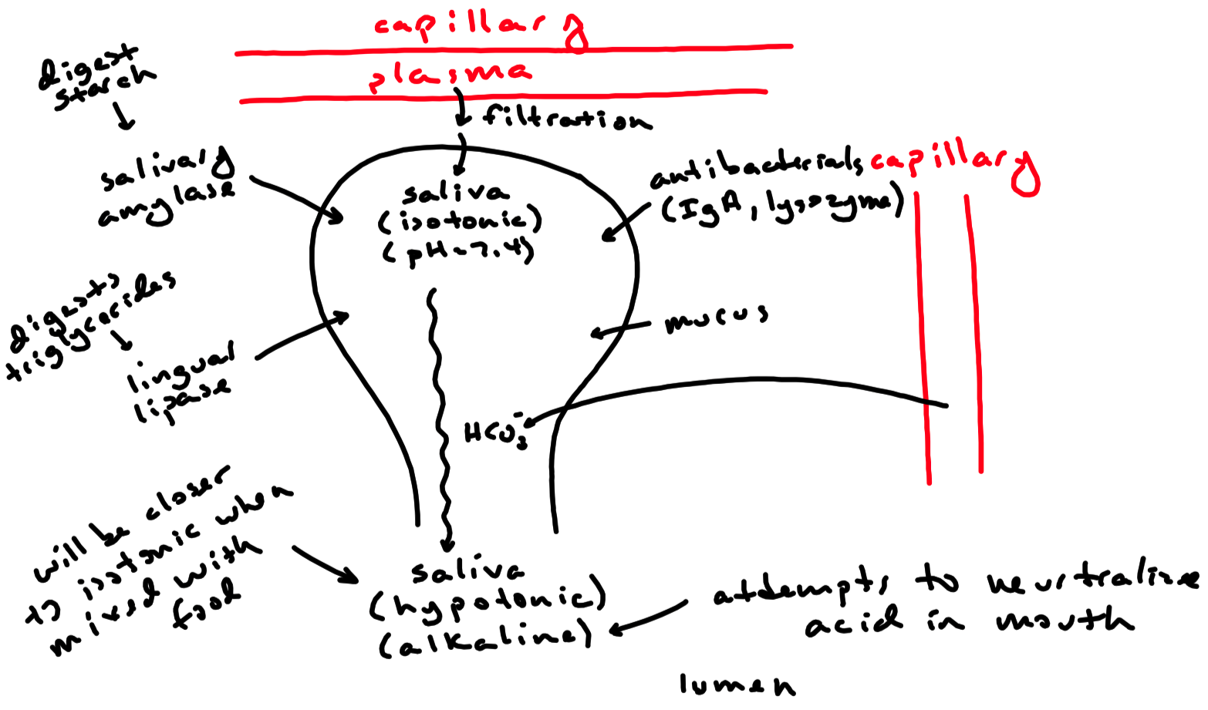

Slide 42
Regulation of Saliva Production
Parasympathetic Nervous System ( main influence )
Stimulates aqueous and enzyme secretions
Sympathetic Nervous System
Stimulates mucous secretion
Stimulation of Release
Sight and smell of food
Presence of anything in the mouth
Nausea
GERD
Inhibition of Release
Dehydration
Sleep

Slide 43
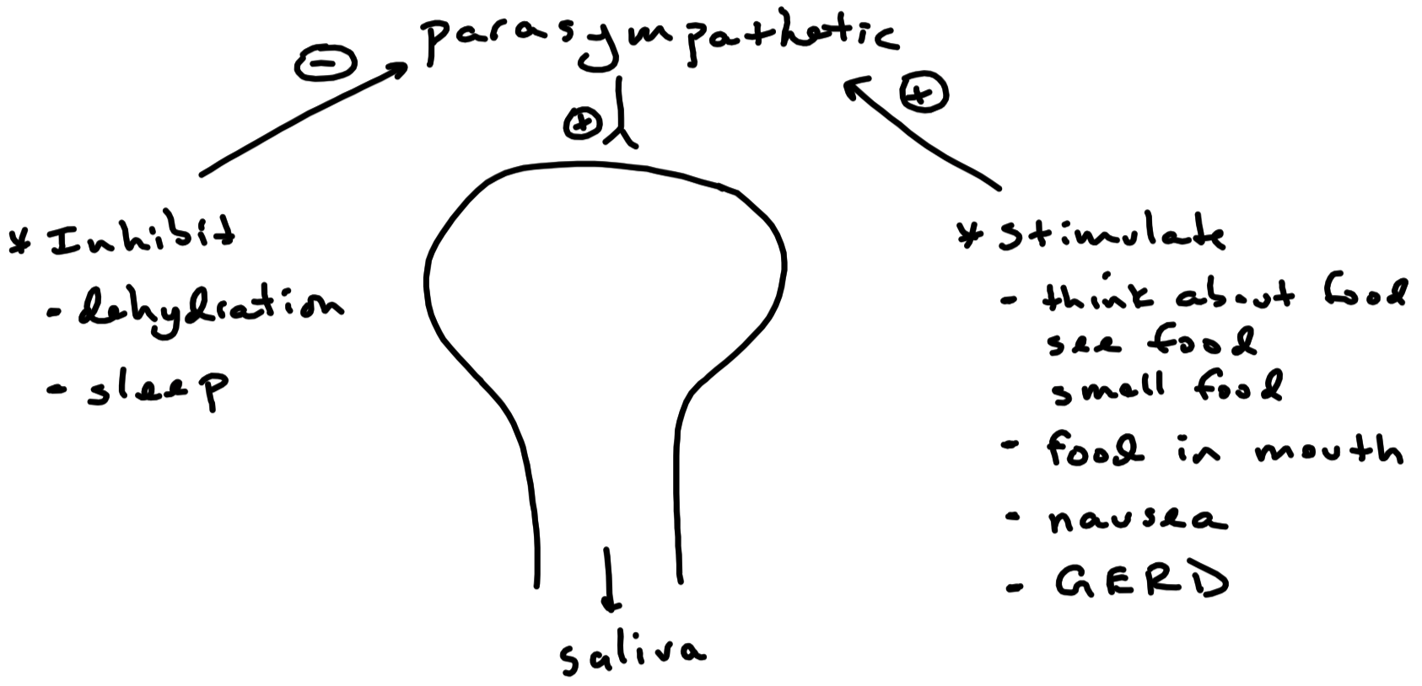

Slide 44
Stomach
Very little digestion occurs in the stomach

Slide 45
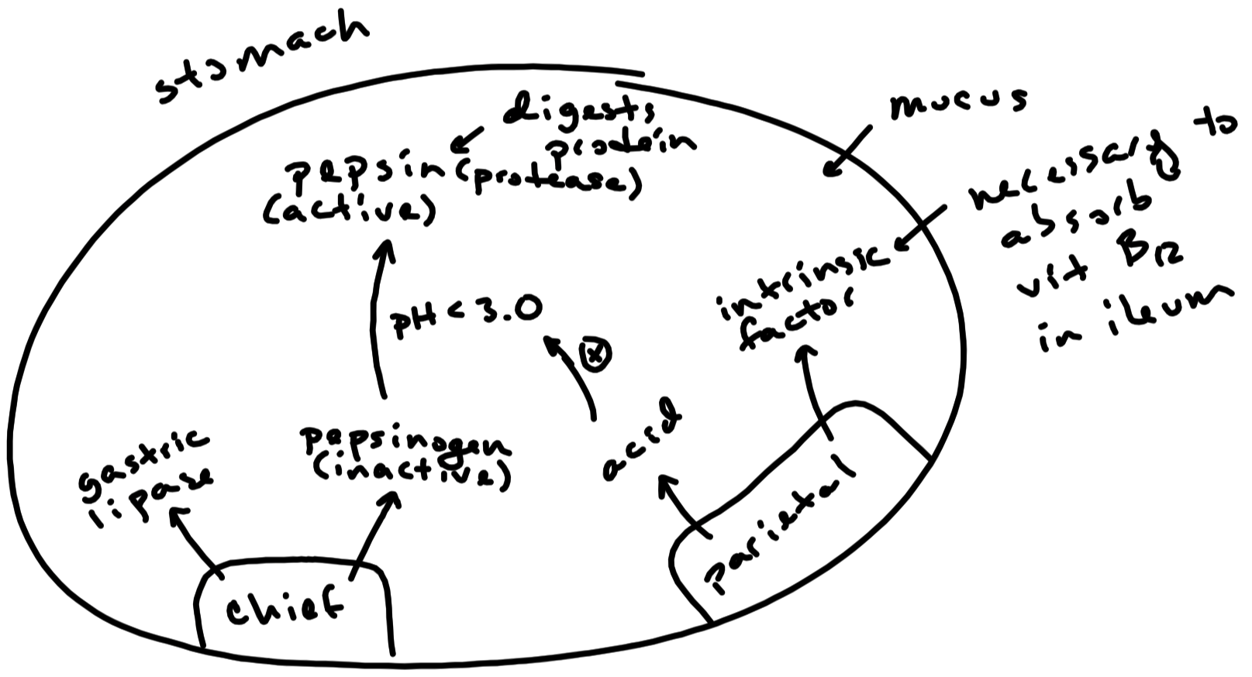

Slide 46
Stomach – Secretions
Pepsin
Protease ( enzyme that digests protein ) released by chief cells
Produced in its inactive form ( pepsinogen )
Activated when pH is below 3.0
Gastric Lipase
Released by chief cells
Digests triglycerides in emulsified fats
Minor role of lipid digestion in adults
Intrinsic Factor
Released by parietal cells
Necessary for proper vitamin B₁₂ absorption in the small intestine
Mucous
Protects stomach from gastric acid and enzymes

Slide 47
Stomach – Secretions
Gastric Acid
Released by parietal cells
Formation of gastric acid
H⁺ / K⁺ Pump ( proton pump ) transports H⁺ into lumen
Decreases gastric pH to as low as 1.0
Inhibited by proton pump inhibitors ( eg , Prilosec , Nexium )
Functions
Decreases pH to activate pepsin
Breaks down connective tissue in meat
Kills bacteria

Slide 48
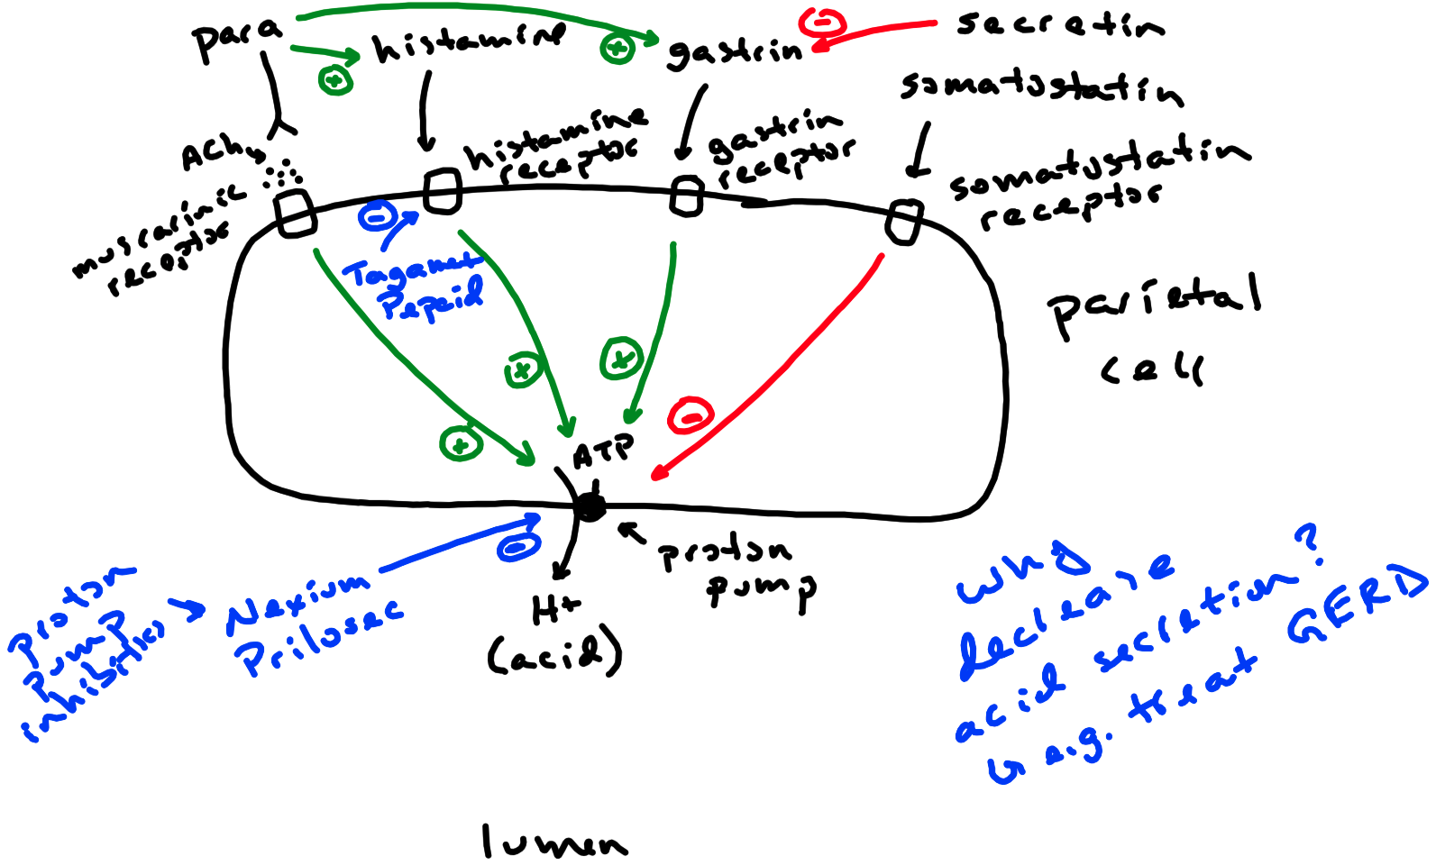

Slide 49
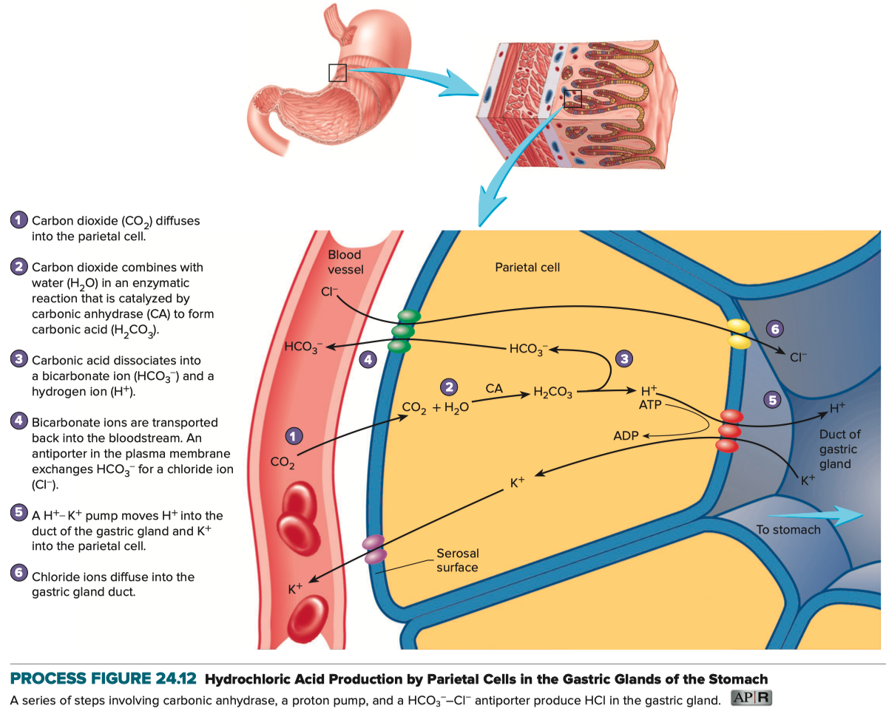
Formation of Gastric Acid

Slide 50
Regulation of Stomach Secretions
Parasympathetics
Stimulates release of gastric acid
Stimulates gastrin and histamine
Gastrin
Stimulates release of gastric acid
Histamine
Stimulates release of gastric acid
Blocked by H₂ antagonists
eg , Tagamet
eg , Pepcid
Somatostatin
Inhibits release of gastric acid
Secretin
Inhibits gastrin ( therefore , indirectly inhibits gastric acid )

Slide 51
Three Phases of Gastric Acid Secretion
Cephalic Phase
Gastric Phase
Intestinal Phase

Slide 52
Gastric Acid Secretion – Cephalic Phase
Taste , smell , or thought of food stimulates medulla oblongata
Stimulates parasympathetics
Stimulates gastric acid , gastrin , and histamine
Gastrin and histamine stimulate gastric acid
Accounts for 30% of gastric acid secretion

Slide 53
Gastric Acid Secretion – Cephalic Phase
Taste , smell or thought of food stimulates medulla oblongata
+
Parasympathetics
+
gastric acid , gastrin , and histamine
+
accounts for 30% of
gastric acid secretion

Slide 54
Gastric Acid Secretion – Gastric Phase
Distension of the stomach stimulates mechanoreceptors
Mechanoreceptors stimulate parasympathetics
Stimulates gastric acid , gastrin , and histamine
Gastrin and histamine stimulate gastric acid
Accounts for 60% of gastric acid secretion

Slide 55
Gastric Acid Secretion – Gastric Phase
Distension of the Stomach
+
Mechanoreceptors of the Stomach
+
Parasympathetics
+
gastric acid , gastrin , and histamine
+
accounts for 60% of
gastric acid secretion

Slide 56
Gastric Acid Secretion – Intestinal Phase
Chyme first emptied by the stomach
Stimulates duodenum to release gastrin
Stimulates the release of gastric acid
Accounts for 10% of gastric acid secretion

Slide 57
Gastric Acid Secretion – Intestinal Phase
Chyme first emptied by stomach
+
Release of gastrin
+
Release of gastric acid
accounts for 10% of gastric acid secretion

Slide 58
Small Intestine
Most digestion occurs in the small intestine
Lining of small intestine greatly increases surface area for digestion
Contains various surface-bound enzymes
Disaccharidases ( digests disaccharides )
Proteases ( digests protein )

Slide 59
Small Intestine
Lysosomal Enzymes
Released by intestinal glands
Glands that extend down between villi into the mucosa
Help maintain fluidity of chyme
Mucous
Protects lining from acidic chyme and digestive enzymes

Slide 60
Small Intestine – Produced Enzymes
Disaccharidases for the final digestion of carbohydrates
Surface-bound to microvilli
Maltase
Digests maltose into glucose + glucose
Sucrase
Digests sucrose into glucose + fructose
Lactase
Digests lactose into glucose + galactose
Proteases for the digestion of protein
Surface-bound to microvilli

Slide 61
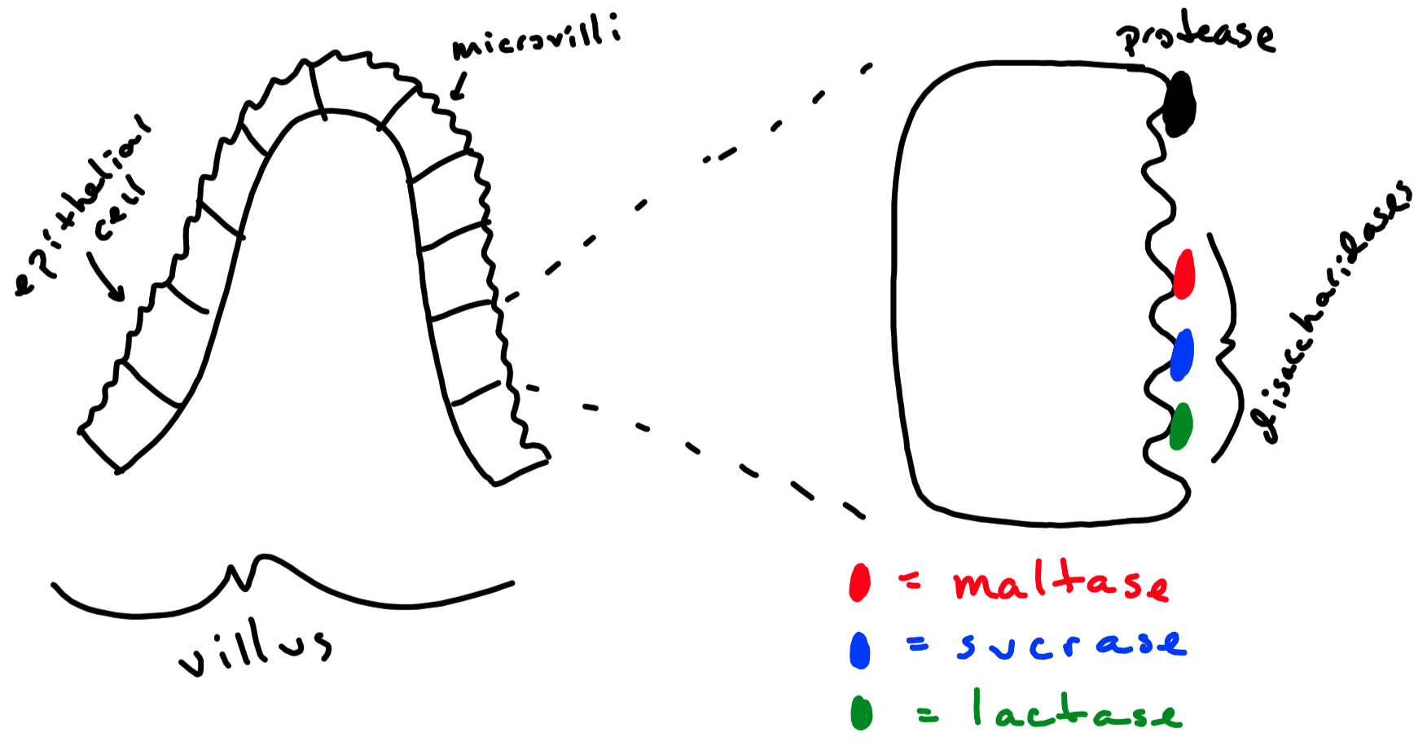

Slide 62
Large Intestine
Flora digest approximately 10% of soluble fiber
Produces short-chain fatty acids ( acetate , propionate , butyrate )
Have anti-inflammatory properties

Slide 63
Accessory Organs
Teeth
Tongue
Salivary Glands
Liver
Gall Bladder
Pancreas

Slide 64
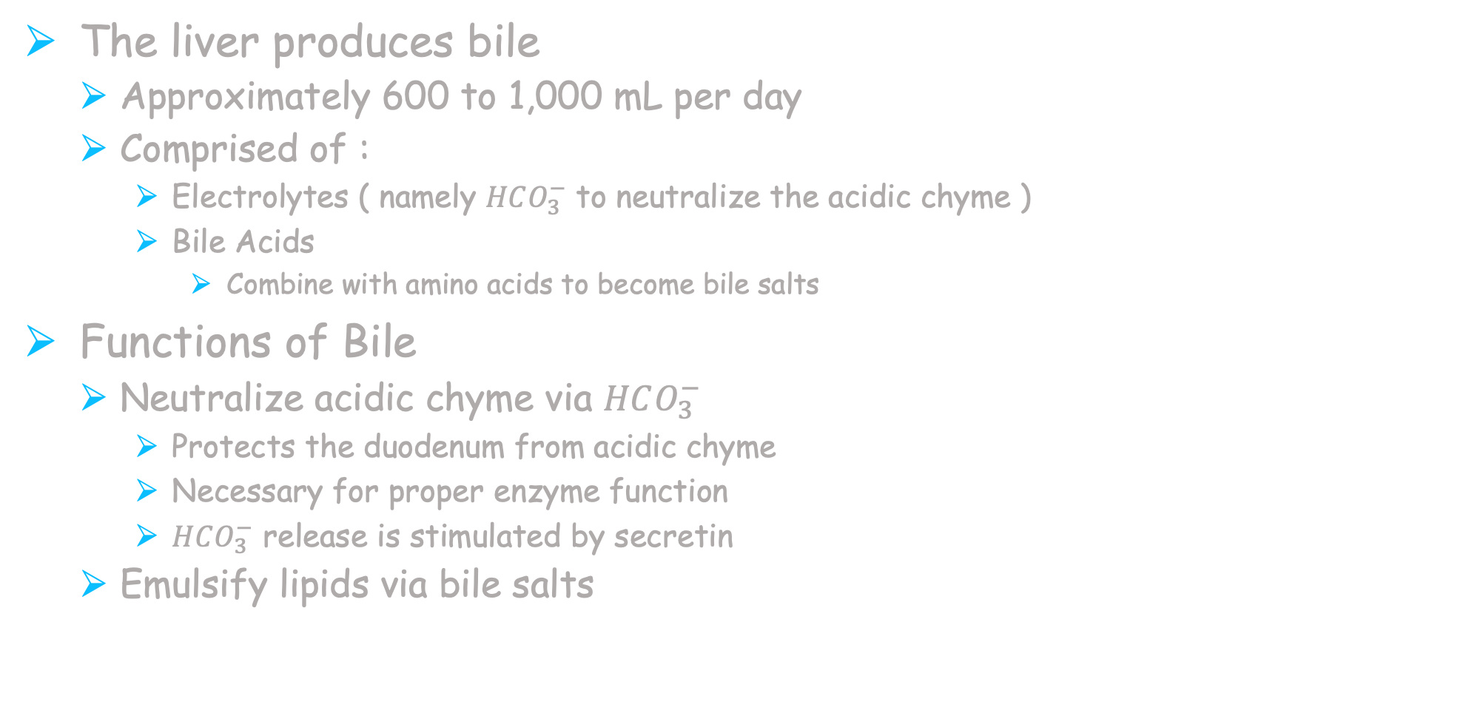
Liver and Gallbladder
The liver produces bile
Approximately 600 to 1,000 mL per day
Comprised of :
Electrolytes ( namely $HCO_{3}^{−}$ to neutralize the acidic chyme )
Bile Acids
Combine with amino acids to become bile salts
Functions of Bile
Neutralize acidic chyme via $HCO_{3}^{−}$
Protects the duodenum from acidic chyme
Necessary for proper enzyme function
$HCO_{3}^{−}$ release is stimulated by secretin
Emulsify lipids via bile salts

Slide 65
Liver and Gallbladder
Bile release from the liver to the gallbladder
Bile is stored , concentrated , and released by the gallbladder
Cholecystokinin causes gallbladder to contract
Causes release of bile into duodenum
In response to acid and lipids in small intestine

Slide 66
Other Functions of the Liver
Glycogenesis
Converts glucose into glycogen for storage
Glycogenolysis
Breaks down glycogen into glucose for use
Gluconeogenesis
Production of glucose from non-carbohydrate sources
Amino acids , lactate , glycerol , and pyruvate
Lipogenesis
Production of lipids from glucose and amino acids
Stores glycogen , iron ( in the form of ferritin ) and vitamins A , D , and B₁₂
Removes nutrients from blood
Adds nutrients to blood
Produces cholesterol and many plasma proteins
Detoxifies alcohol and many drugs and toxins that enter the body
Phagocytizes bacteria and worn out red blood cells
Deaminates amino acids ( ammonia produced as a consequence )
Converts ammonia into urea

Slide 67
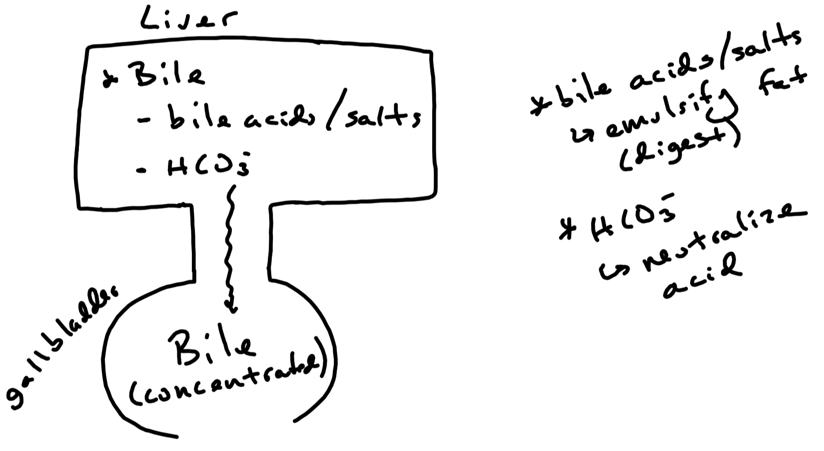

Slide 68
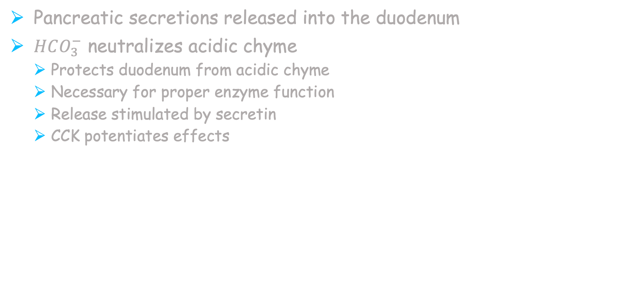
Pancreas
Pancreatic secretions released into the duodenum
$HCO_{3}^{−}$ neutralizes acidic chyme
Protects duodenum from acidic chyme
Necessary for proper enzyme function
Release stimulated by secretin
CCK potentiates effects

Slide 69
Pancreas – Organic Secretions
Pancreatic Amylase
Continues digestion of starch into disaccharides
Pancreatic Lipase
Digestion of lipid
Digests triglycerides into fatty acids and monoglycerides
Cholesterol Esterase
Digests cholesterol esters into cholesterol and fatty acids
Proteases
Digest protein into polypeptides , tripeptides , dipeptides , and amino acids
Pancreatic Secretions Release stimulated by cholecystokinin

Slide 70
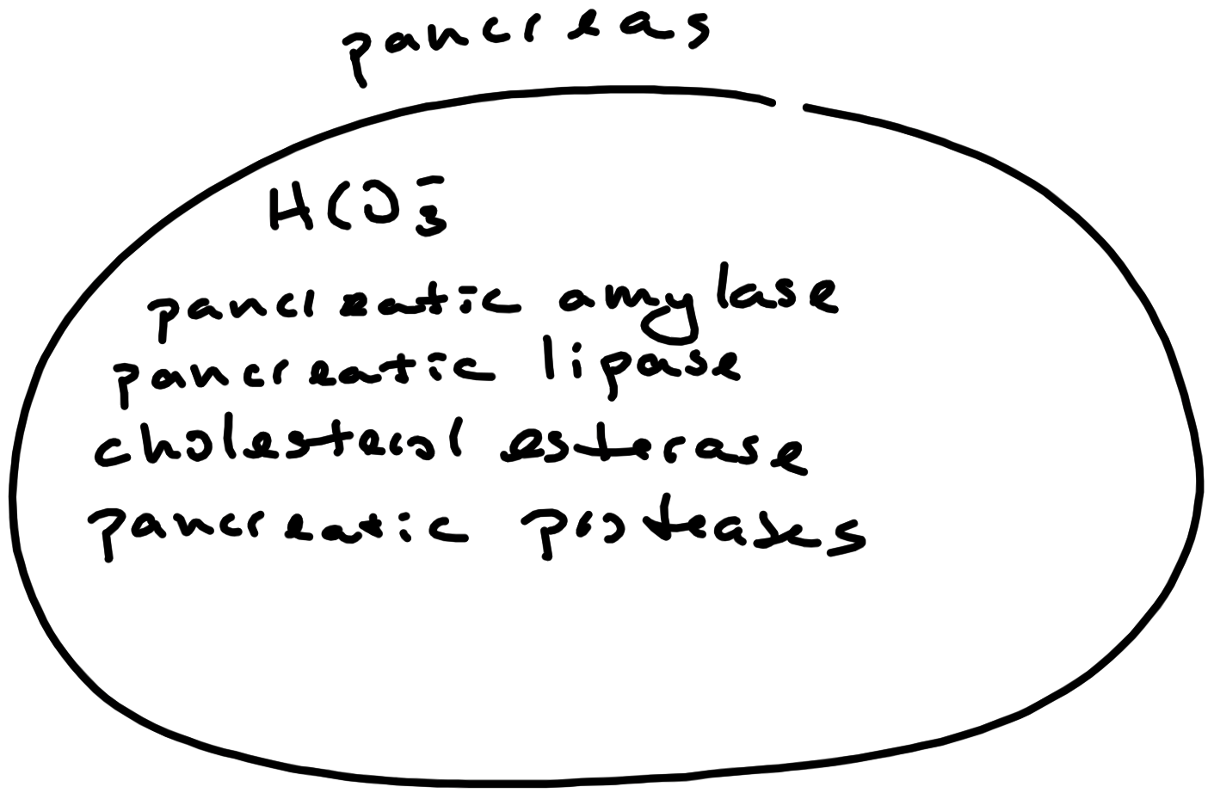

Slide 71
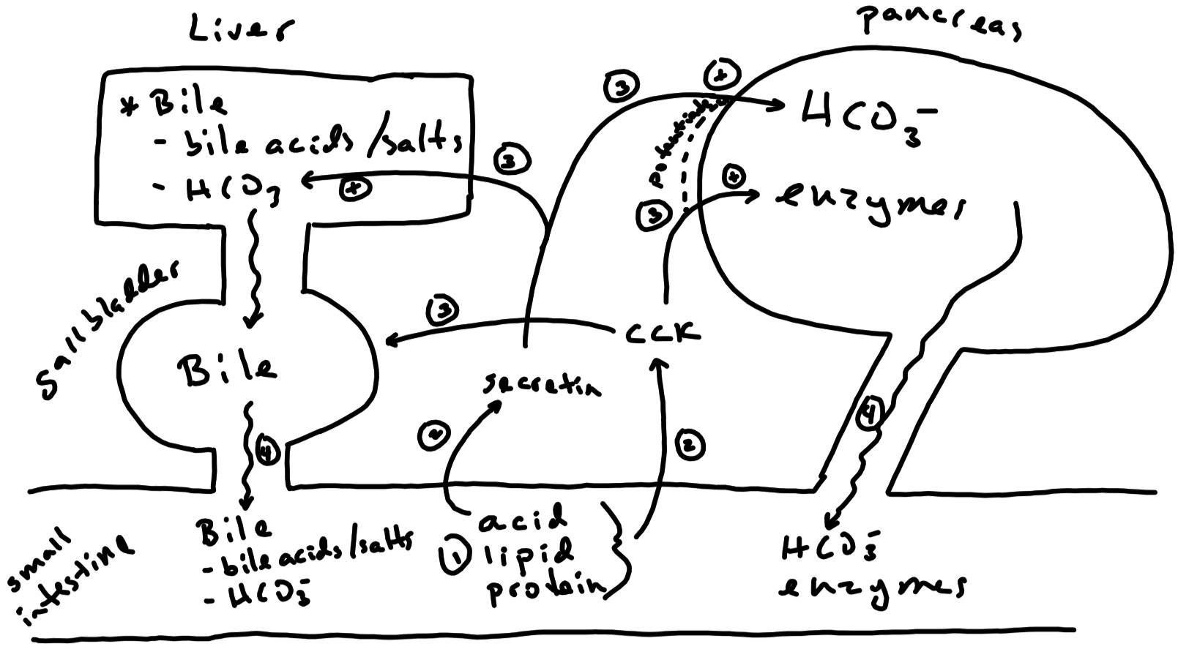

Slide 72
Summary of Carbohydrate Digestion
Mouth
Salivary Amylase
Polysaccharide ( starch ) into disaccharide ( maltose )
Small Intestine
Pancreatic Amylase
Polysaccharide ( starch ) into disaccharide ( maltose )
Maltase surface-bound to microvilli
Disaccharide ( maltose ) into monosaccharide ( glucose )
Sucrase surface-bound to microvilli
Disaccharide ( sucrose ) into monosaccharides ( glucose + fructose )
Lactase surface-bound to microvilli
Disaccharide ( lactose ) into monosaccharides ( glucose + galactose)
Lactose intolerance = lack of lactase
Cannot digest lactose
Can lead to hypertonic chyme
Can lead to osmotic diarrhea
Flora feed off of lactose and produce gas

Slide 73
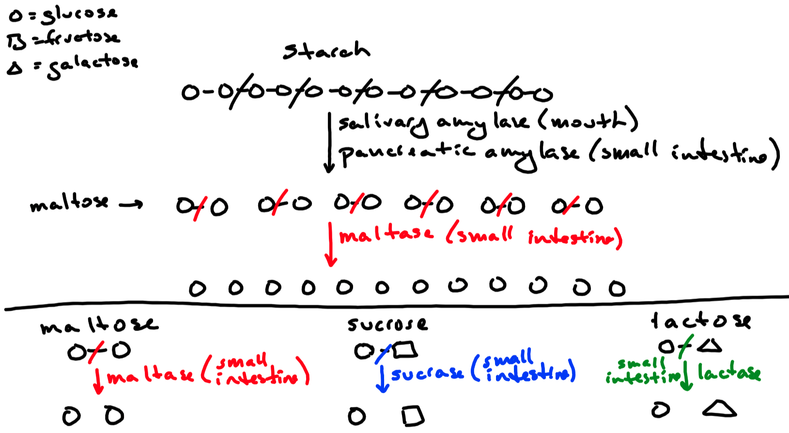

Slide 74
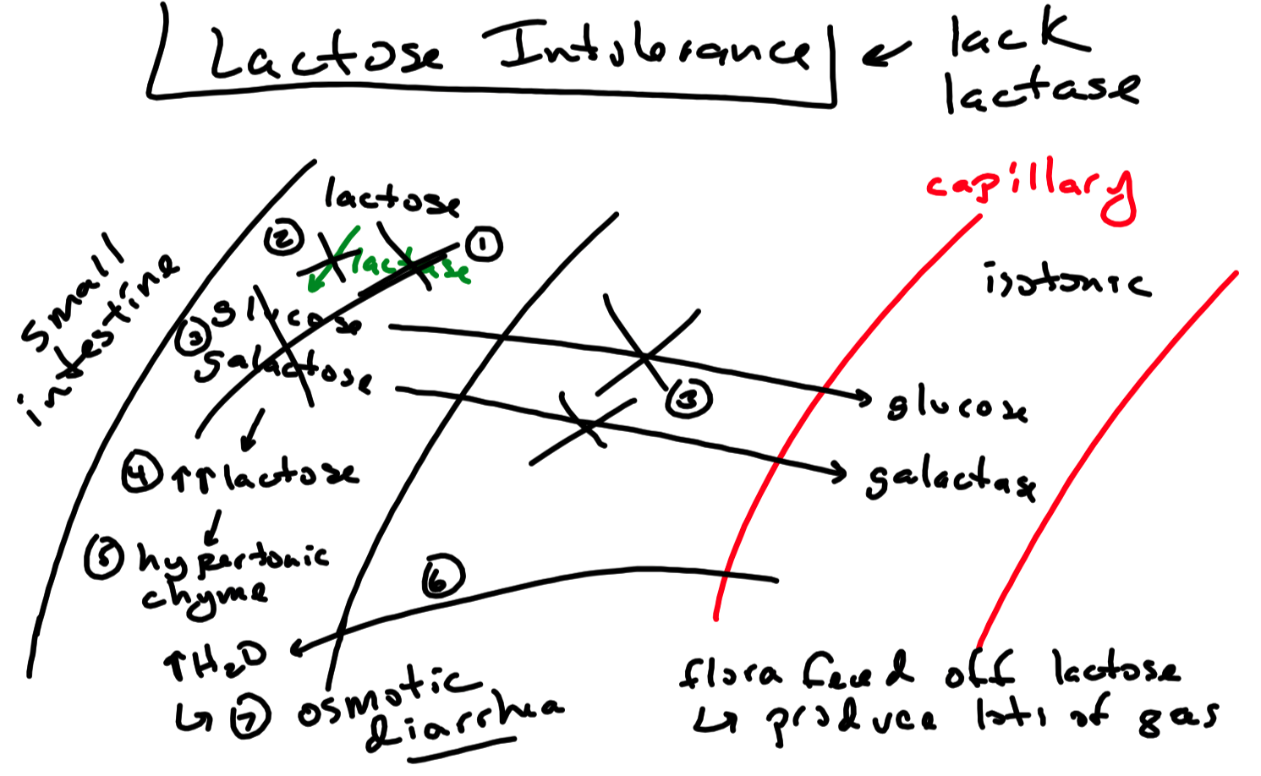

Slide 75
Carbohydrate Digestion
Polysaccharide ( starch )
Disaccharide ( maltose )
Salivary amylase from salivary glands
Digestion in mouth
Pancreatic amylase from pancreas
Digestion in small intestine
Maltase from duodenum ( digestion in small intestine )
Digests maltose into glucose + glucose
Disaccharides ( sucrose and lactose )
Monosaccharide ( glucose )
Sucrase from duodenum ( digestion in small intestine )
Digests sucrose into glucose + fructose
Lactase from duodenum ( digestion in small intestine )
Digests lactose into glucose + galactose
Monosaccharides ( glucose , fructose , galactose )

Slide 76
Summary of Protein Digestion
Stomach
Pepsin
Proteins into polypeptides
Small Intestine
Proteases surface-bound to microvilli
Proteins into tripeptides , dipeptides , and amino acids
Pancreatic Proteases
Proteins into polypeptides , tripeptides , dipeptides , and amino acids

Slide 77
Protein Digestion
Protein
Pepsin from stomach
( digestion in stomach )
Pancreatic proteases
( digestion in small intestine )
Trypsin
Chymotrypsin
Carboxypeptidase
Polypeptides
Peptidase and aminopeptidase from duodenum
( digestion in small intestine )
Tripeptides , Dipeptides , Amino Acids

Slide 78
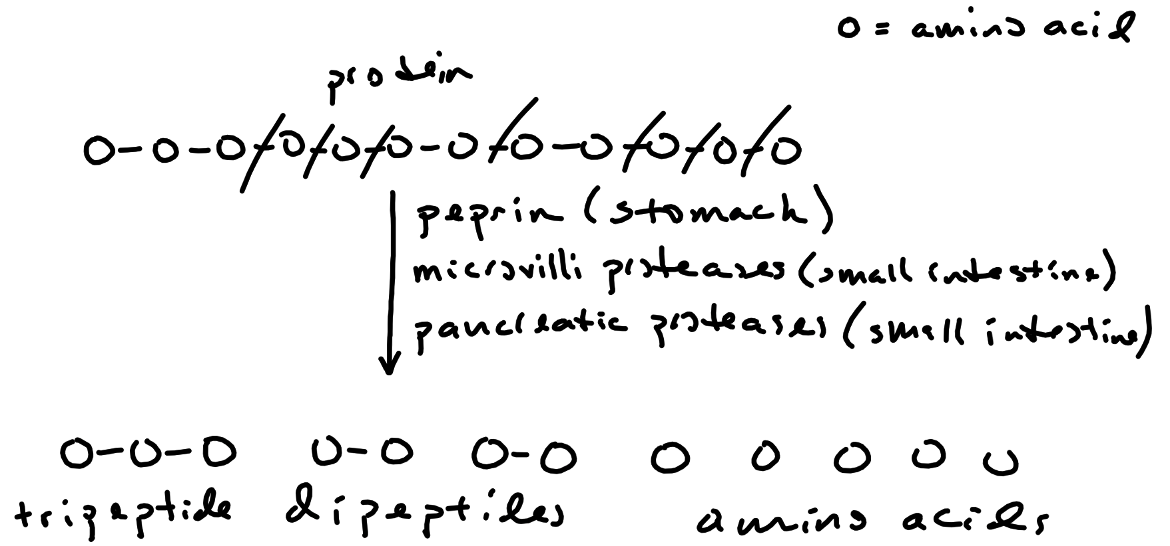

Slide 79
Summary of Fat / Lipid Digestion
Mouth
Lingual Lipase
Emulsified lipid ( ie , triglycerides ) into monoglycerides and fatty acids
Stomach
Gastric Lipase
Emulsified lipid ( ie , triglycerides ) into monoglycerides and fatty acids
Small Intestine
Bile
Lipids into emulsified lipid ( ie , triglycerides )
Pancreatic Lipase
Emulsified lipid ( ie , triglycerides ) into fatty acids + monoglycerides
Cholesterol Esterase
Cholesterol ester into cholesterol + fatty acids

Slide 80
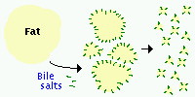
Emulsification
fat droplets
Bile salts surround dietary lipid / fat to form small , lipid / fat droplets ( triglycerides )

Slide 81
Fat Digestion
Fat / Lipid
Emulsified Fat ( Triglycerides )
Lingual lipase ( digestion in mouth )
Gastric lipase ( digestion in stomach )
Pancreatic lipase ( digestion in duodenum )
Bile from gall bladder
( emulsification in small intestine )
Fatty acids + monoglycerides
Triglycerides
Pancreatic lipase ( digestion in small intestine )
Fatty acids + monoglycerides

Slide 82
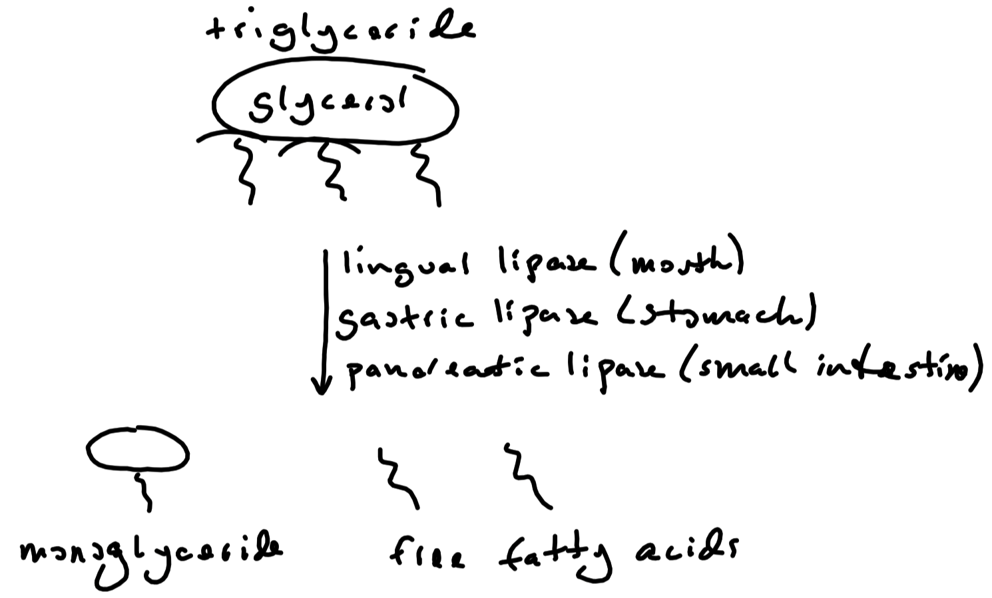

Slide 83
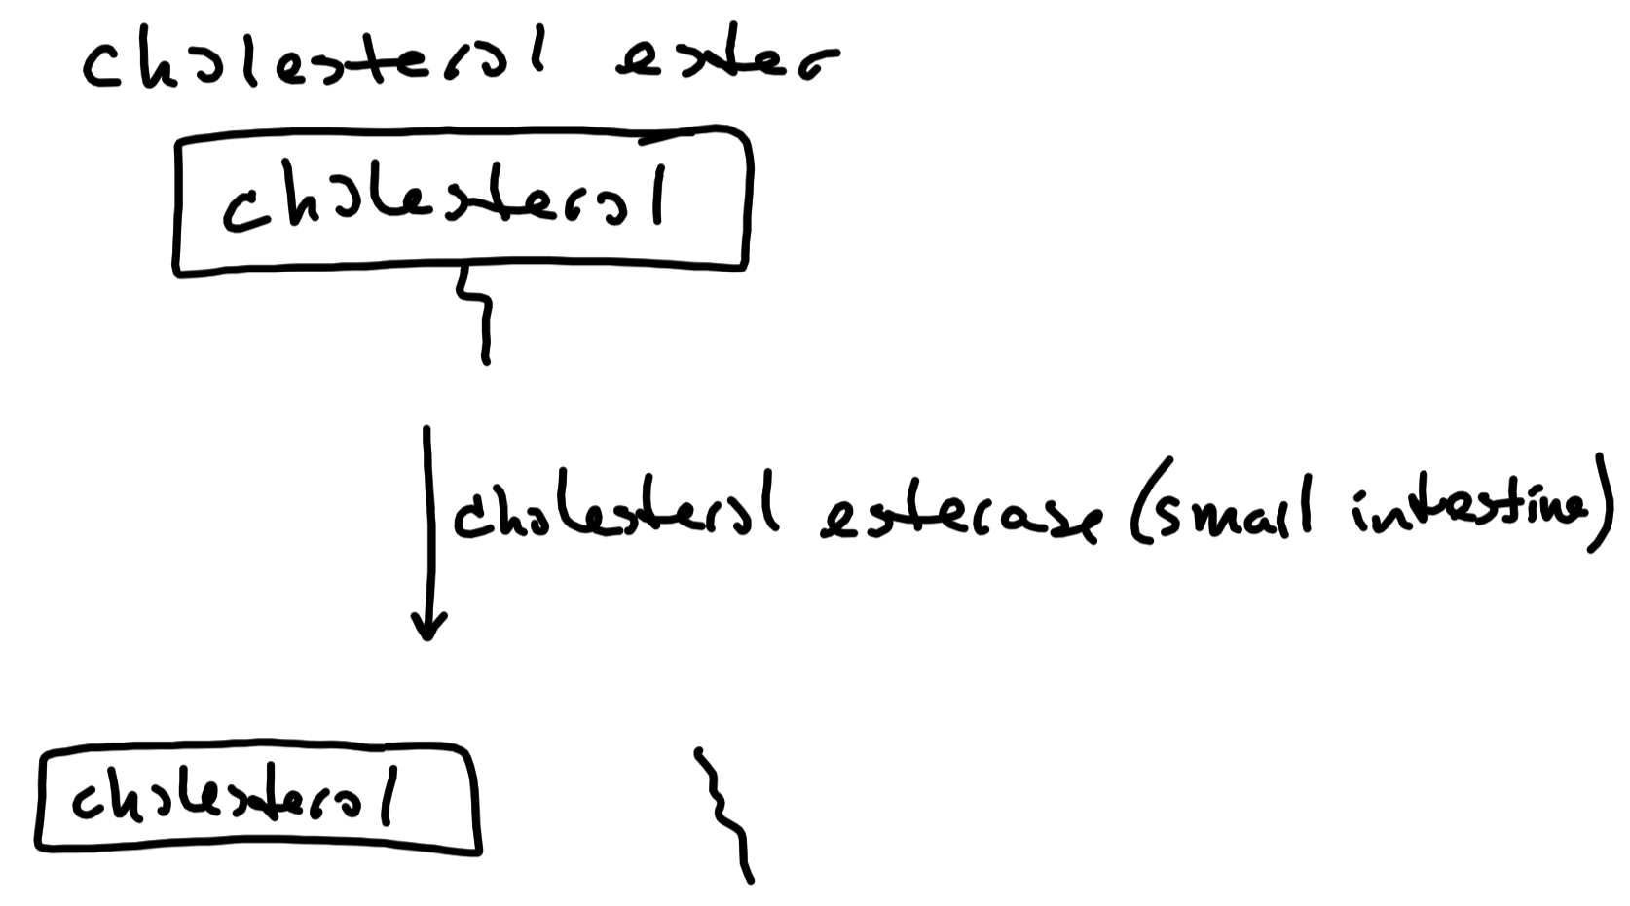

Slide 84
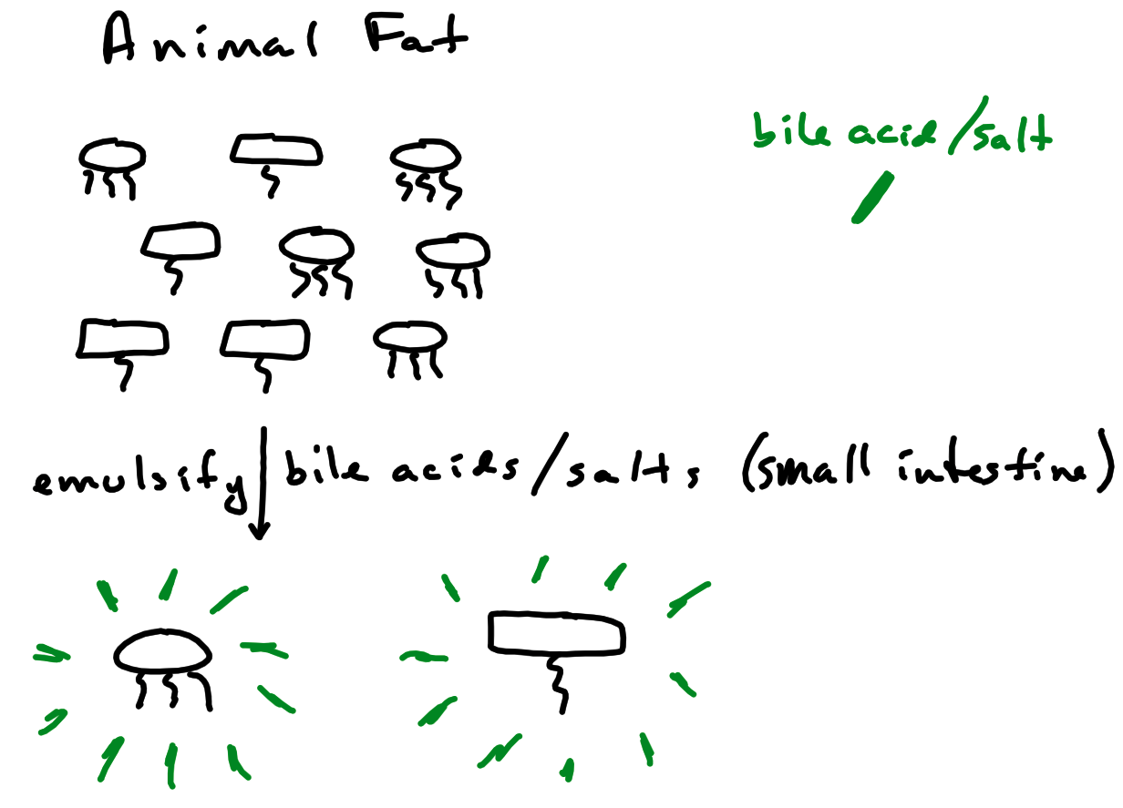

Slide 85
Absorption of Nutrients
Stomach
Very little absorption takes place in the stomach
Some water and electrolytes as well as lipid and alcohol absorbed
Small Intestine
Most absorption occurs in the small intestine through small intestine epithelial cells
Large Intestine
Approximately 1.5 liters of chyme enters the large intestine per day
90% of that volume is absorbed as water and electrolytes
Absorption of vitamin K and biotin ( vitamin B7 ) and short-chain fatty acids

Slide 86
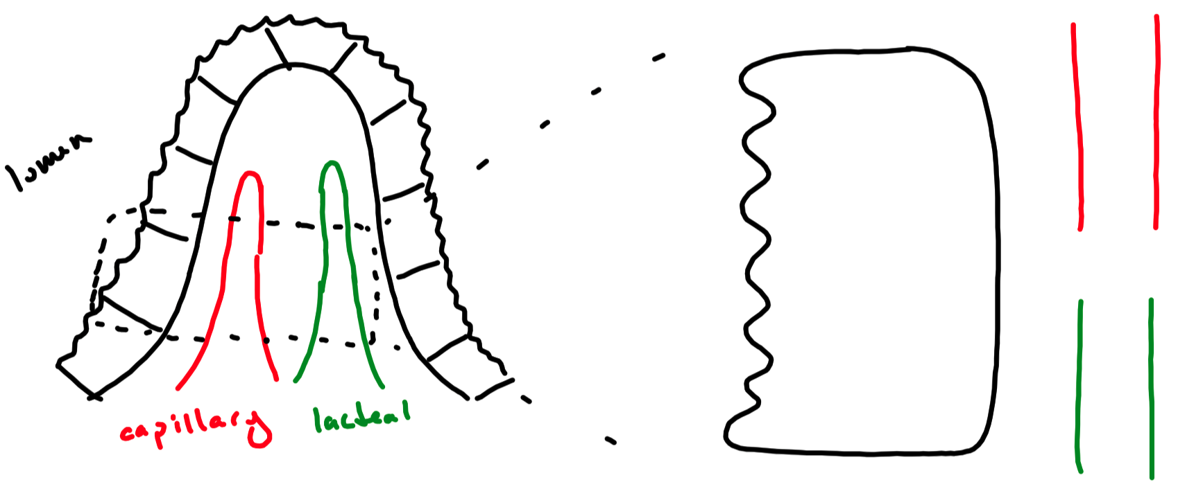

Slide 87
Absorption of Monosaccharides
Monosaccharides from carbohydrate digestion
Absorbed by epithelial cells of villi via secondary active transport
Enter blood capillaries via facilitated diffusion
Enter the hepatic portal system and transported to the liver

Slide 88
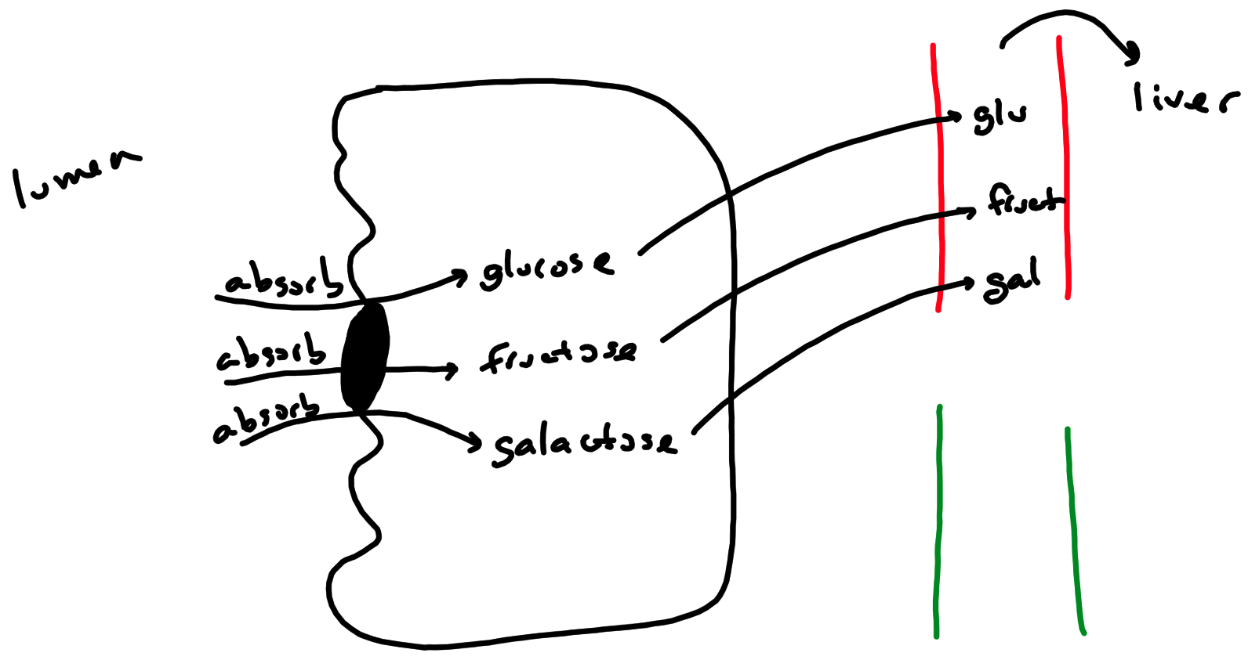

Slide 89
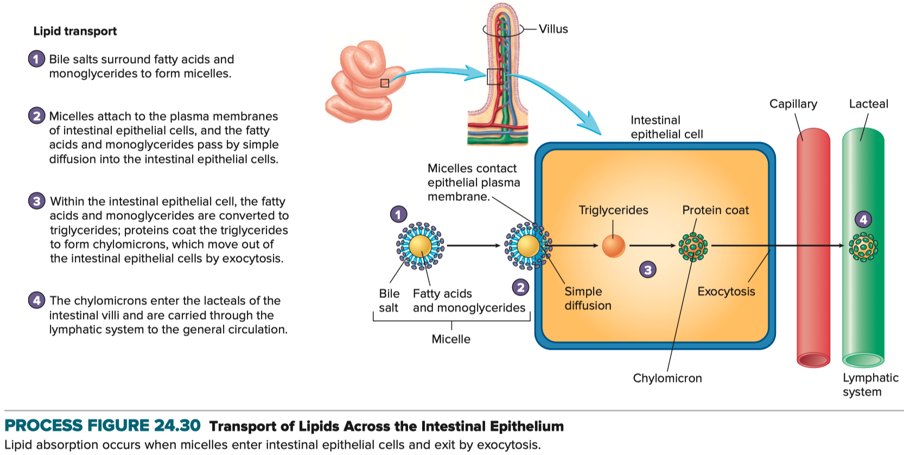
Absorption of Monosaccharides

Slide 90
Absorption of Amino Acids , Dipeptides , and Tripeptides
Amino acids , dipeptides , and tripeptides from protein digestion
Absorbed by epithelial cells of villi via secondary active transport
Most dipeptides and tripeptides broken down into individual amino acids
Amino acids , dipeptides , and tripeptides enter capillaries via facilitated diffusion
Enter the hepatic portal system and transported to the liver

Slide 91
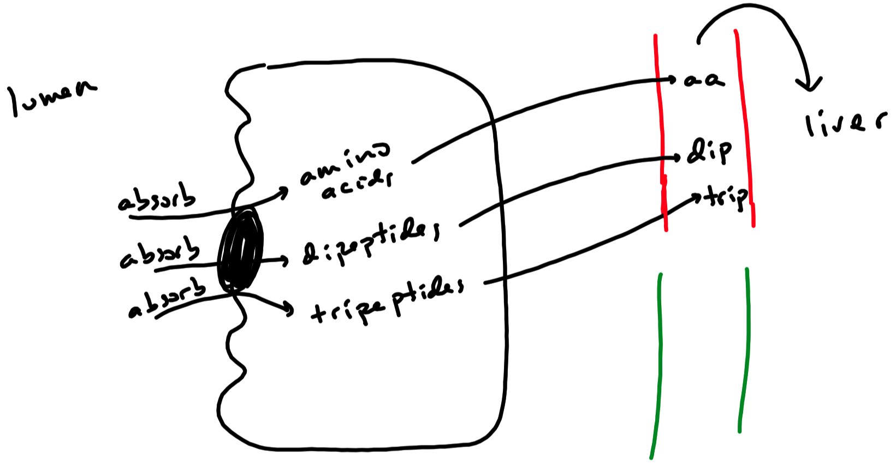

Slide 92
Absorption of Fatty Acids and Monoglycerides
Surrounded by bile salts in the small intestines to form micelles
Monoglycerides , fatty acids , and cholesterol absorbed by epithelial cells of villi via simple diffusion
Fatty acids and monoglycerides combine to form triglycerides
Fatty acids and cholesterol combine to form cholesterol esters
Triglycerides and cholesterol esters used to make chylomicrons ( lipoprotein )
Chylomicrons exit epithelial cells via exocytosis
Chylomicrons then endocytosed into lacteals
Enter lymphatic system and subsequently carried to the blood

Slide 93
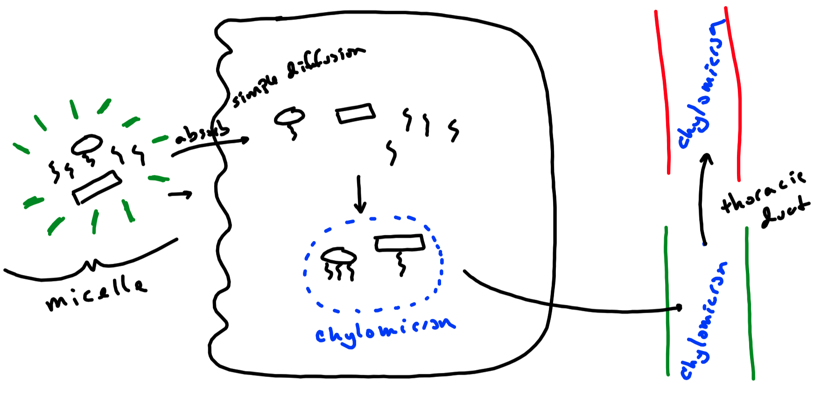

Slide 94
Absorption of Water
Approximately 9 liters of water enters the digestive tract each day ( ~ 99% absorbed )
Approximately 5% absorbed in the stomach
Approximately 85% absorbed in the small intestine
Approximately 10% absorbed in the large intestine
Movement of water dictated by movement of nutrients
As nutrients are absorbed , water follows osmotically

Slide 95
Defining pH
pH = - log [ H⁺ ]
Increase [ H⁺ ] → decrease pH
Decrease [ H⁺ ] → increase pH
pH scale: 0 - 14
pH 7.0 10⁻⁷ or 0.0000001 moles H⁺ / L
pH 7.2 10^{-7.2} or 0.000000063 moles H⁺ / L
pH 7.4 10^{-7.4} or 0.000000040 moles H⁺ / L
pH 7.6 10^{-7.6} or 0.000000025 moles H⁺ / L
pH 8.0 10⁻⁸ or 0.00000001 moles H⁺ / L
Body must maintain blood pH within its normal range
Normal arterial pH range: 7.35 to 7.45
Abnormal: pH < 7.35 ( acidosis )
Abnormal: pH > 7.45 ( alkalosis )
pH changes minimized by pH buffers
pH is regulated ( compensated ) towards normal by lungs and/or kidneys

Slide 96
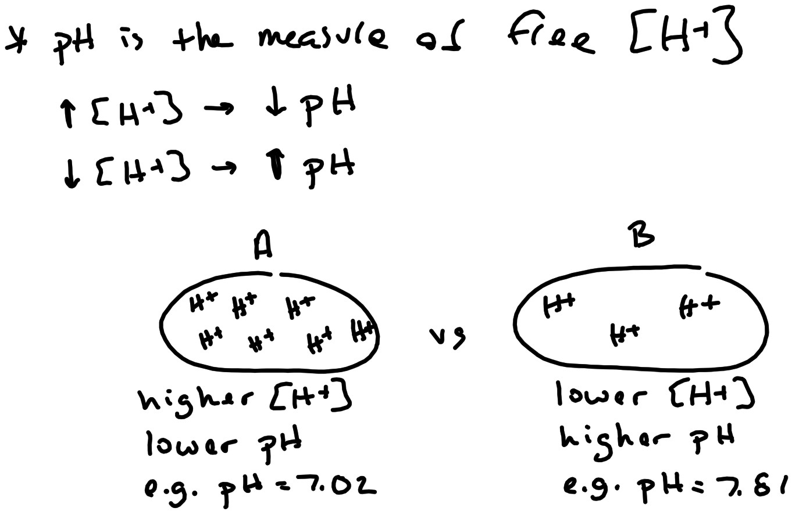

Slide 97


Slide 98
Control of pH
pH Buffering Systems
pH Regulation
Lungs
Kidneys

Slide 99
Control of pH
pH Buffers :
Minimize changes in pH with added acid or base
Buffers bind H⁺ with added acid
Buffers release H⁺ with added base
pH buffers DO NOT regulate / compensate pH changes
Types of Buffering Systems :
Carbon Dioxide / Bicarbonate Buffer System
Strongest buffering system

Slide 100


Slide 101


Slide 102


Slide 103


Slide 104

pH Regulation
Arterial Blood pH ~ 7.40
Range : 7.35 – 7.45
Arterial Blood $\left[HCO_{3}^{−}\right]$ ~ 24 mEq / L
Range : 22 – 26 mEq / L
Arterial Blood $P_{CO_{2}}$ $\left({P_{a}}_{CO_{2}}\right)$ ~ 40 mm Hg
Range : 35 – 45 mm Hg
$CO_{2}+H_{2}O⇌H_{2}CO_{3}⇌H^{+}+HCO_{3}^{−}$
Ratio of $\left[HCO_{3}^{−}\right]$ to $\left[CO_{2}\right]$ dictates pH … calculated by the Henderson-Hasselbach equation. Simplified form :
$$pH∝\frac{\left[HCO_{3}^{−}\right]}{P_{CO_{2}}}$$

Slide 105


Slide 106

pH Regulation – Changing pH
$↑PCO_{2} ⟶ ↑H^{+} formation⟶ ↑\left[H^{+}\right]⟶ ↓pH$
$↓PCO_{2} ⟶ ↓H^{+} formation⟶ ↓\left[H^{+}\right]⟶ ↑pH$
$↑\left[HCO_{3}^{−}\right] ⟶ binds more H^{+}⟶ ↓\left[H^{+}\right]⟶ ↑pH$
$↓\left[HCO_{3}^{−}\right] ⟶ binds less H^{+}⟶ ↑\left[H^{+}\right]⟶ ↓pH$
$↑acid \left( eg. ketoacid \right)⟶ ↑\left[H^{+}\right] and ↓\left[HCO_{3}^{−}\right]⟶ ↓pH$

Slide 107


Slide 108

Acid – Base Disturbances
Respiratory Alkalosis
Decreased level of arterial $P_{CO_{2}}$ ( less than 35 mm Hg )
Causes a pH > 7.45
Caused by hyperventilation
eg , Hyperthyroidism
Stimulates respiratory center via increased T₃ and T₄
eg , Anxiety Attack
Stimulates respiratory center via hypothalamus
eg , Acute aspirin toxicity
Stimulates respiratory center
Respiratory Acidosis
Increased level of arterial $P_{CO_{2}}$ ( greater than 45 mm Hg )
Causes a pH < 7.45
Caused by hypoventilation of poor gas exchange at the lungs
eg , Pulmonary diseases
Decrease ventilation and poor gas exchange
eg , Hypothyroidism
Decreased T₃ and T₄ depresses respiratory center
eg , Opiates ( eg , morphine ) benzodiazepines ( eg , Xanax )
Inhibit respiratory center

Slide 109


Slide 110


Slide 111


Slide 112


Slide 113


Slide 114


Slide 115

Respiratory Center
Bilateral network of neurons with pacemaker-like activity in the medulla
Dorsal Respiratory Group :
Innervate and drive the respiratory muscles
Ventral Respiratory Group :
Innervate and drive the respiratory muscles
Contains pacemaker neurons
pre-Bötzinger complex

Slide 116

Acid – Base Disturbances – Metabolic Alkalosis
Failure of the kidneys to maintain a normal arterial blood $HCO_{3}^{−}$
Increased level of arterial $HCO_{3}^{−}$ ( greater than 26 mEq / L )
Causes a pH > 7.45
Caused by :
eg , Gastric vomiting
Loss of stomach acids results in increased stomach pH
More gastric acid produced to replace lost acid
Results in $HCO_{3}^{−}$ transport into the blood
eg , Ingestion of too many alkaline drugs
Increases stomach pH
More gastric acid produced to normalize pH
Results in $HCO_{3}^{−}$ transport into the blood

Slide 117

Acid – Base Disturbances – Metabolic Acidosis
Failure of the kidneys to maintain a normal arterial blood $HCO_{3}^{−}$
Decreased level of arterial $HCO_{3}^{−}$ ( less than 22 mEq / L )
Causes a pH < 7.35
Caused by :
eg , Kidney disease
Failure to reabsorb $HCO_{3}^{−}$ and / or secrete $H^{+}$
eg , Diarrhea
Rapid excretion of $HCO_{3}^{−}$ from digestive tract
Lost $HCO_{3}^{−}$ acquired from the plasma
eg , Acetylsalicylic acid ( asiprin ) toxicity
eg , Ketoacidosis

Slide 118
Compensation of Acid – Base Disturbances
Regulation of pH back towards normal
Performed by the lungs and / or kidneys
With a metabolic disturbance :
If due to kidney disease , only the lungs can compensate
If kidneys are not damage , kidneys can compensate too
If there is a respiratory disturbance , the kidneys will compensate

Slide 119


Slide 120

Compensation of Acid – Base Disturbances
Respiratory Compensation ( ie , lungs regulate pH back to normal ) :
Performed by the lungs via changes in alveolar ventilation
Lungs compensate in minutes to hours
Lungs compensate metabolic disturbances
Disturbance : Metabolic Alkalosis ( ie , increase in $HCO_{3}^{−}$ )
Body responds with respiratory compensation
Decrease ventilation → increases $P_{CO_{2}}$
Decrease pH back towards normal
Disturbance : Metabolic Acidosis ( ie , decrease in $HCO_{3}^{−}$ )
Body responds with respiratory compensation
Increase ventilation → decreases $P_{CO_{2}}$
Increase pH back toward normal

Slide 121


Slide 122

Compensation of Acid – Base Disturbances
Metabolic Compensation ( ie , kidneys regulate pH back to normal )
Performed by the kidneys via changes in reabsorption and secretion
Kidneys take days to compensate
Compensate respiratory disturbances
Compensate metabolic disturbances if not due to kidney issue
Disturbance : Respiratory Alkalosis ( ie , decreases in $P_{CO_{2}}$ )
Body responds with metabolic compensation
Decrease secretion of $H^{+}$
Decrease reabsorption of $HCO_{3}^{−}$
Above decrease pH back towards normal
Disturbance : Respiratory Acidosis ( ie , increase in $P_{CO_{2}}$ )
Body responds with metabolic compensation
Increase secretion of $H^{+}$
Increase reabsorption of $HCO_{3}^{−}$
Above increase pH back towards normal

Slide 123

Compensation of Acid – Base Disturbances
Metabolic compensation ( ie , kidneys regulate pH back to normal )
Performed by the kidneys via changes in reabsorption and secretion
Kidneys take days to compensate
Compensate respiratory disturbances
Compensate metabolic disturbances if not due to kidney issue
Disturbance : Metabolic Alkalosis ( ie , increase in $HCO_{3}^{−}$ )
Body responds with metabolic compensation
ONLY if there is no kidney injury or disease
Decrease secretion of $H^{+}$
Decrease reabsorption of $HCO_{3}^{−}$
Above decrease pH back towards normal
Disturbance : Metabolic Acidosis ( ie , decrease in $HCO_{3}^{−}$ )
Body responds with metabolic compensation
ONLY if there is no kidney injury or damage
Increase secretion of $H^{+}$
Increase reabsorption of $HCO_{3}^{−}$
Above increase pH back towards normal

Slide 124


Slide 125

Compensation of Acid – Base Disturbances
No Compensation :
Disturbance has yet to be regulated
pH is abnormal and either $P_{CO_{2}}$ or $HCO_{3}^{−}$ is also abnormal
If $P_{CO_{2}}$ is abnormal , then $HCO_{3}^{−}$ will be normal
If $HCO_{3}^{−}$ is abnormal , then $P_{CO_{2}}$ will be normal
Certain disturbances where pH , $P_{CO_{2}}$ and $HCO_{3}^{−}$ are all abnormal
If $P_{CO_{2}}$ is increased , $HCO_{3}^{−}$ will be decreased
If $P_{CO_{2}}$ is decreased , $HCO_{3}^{−}$ will be increased
Partial Compensation :
Disturbance is being regulated toward normal
pH , $P_{CO_{2}}$, and $HCO_{3}^{−}$ will be abnormal
$P_{CO_{2}}$ and $HCO_{3}^{−}$ will both be increased or both will be decreased
Full Compensation :
Disturbance has been regulated to normal
pH will be normal but both $P_{CO_{2}}$ and $HCO_{3}^{−}$ will be abnormal
$P_{CO_{2}}$ and $HCO_{3}^{−}$ will both be increased or both will be decreased

Slide 126


Slide 127


Slide 128
Examples of Acid – Base Disturbances
Resp Acidosis w. no comp Resp Acidosis w. partial comp Resp Acidosis w. full comp.
pH 7.15 pH 7.26 pH 7.35
P_{CO2} 65 mm Hg P_{CO2} 65 mm Hg P_{CO2} 65 mm Hg
[HCO₃⁻] 22 mEq/L [HCO₃⁻] 28 mEq/L [HCO₃⁻] 35 mEq/L
Met Acidosis w. no comp Met Acidosis w. partial comp Met Acidosis w. full comp.
pH 7.18 pH 7.29 pH 7.37
P_{CO2} 39 mm Hg P_{CO2} 30 mm Hg P_{CO2} 25 mm Hg
[HCO₃⁻] 14 mEq/L [HCO₃⁻] 14 mEq/L [HCO₃⁻] 14 mEq/L
Resp Alkalosis w. no comp Resp Alkalosis w. partial comp Resp Alkalosis w. full comp.
pH 7.57 pH 7.51 pH 7.41
P_{CO2} 26 mm Hg P_{CO2} 26 mm Hg P_{CO2} 26 mm Hg
[HCO₃⁻] 23 mEq/L [HCO₃⁻] 20 mEq/L [HCO₃⁻] 16 mEq/L
Met Alkalosis w. no comp Met Alkalosis w. partial comp Met Alkalosis w. full comp.
pH 7.54 pH 7.49 pH 7.43
P_{CO2} 42 mm Hg P_{CO2} 49 mm Hg P_{CO2} 55 mm Hg
[HCO₃⁻] 35 mEq/L [HCO₃⁻] 35 mEq/L [HCO₃⁻] 35 mEq/L

Slide 129
Examples of Acid – Base Disturbances
Mixed Disturbance :
When two or more disturbances occur simultaneously
eg , respiratory acidosis with a simultaneous metabolic acidosis
pH 7.01
P_{CO2} 58 mm Hg
[HCO₃⁻] 14 mEq/L
eg , respiratory alkalosis with a simultaneous metabolic alkalosis
pH 7.79
P_{CO2} 23 mm Hg
[HCO₃⁻] 34 mEq/L
And then things can get very complicated :
eg , metabolic acidosis with a respiratory alkalosis
eg , metabolic alkalosis with a respiratory acidosis
eg , metabolic acidosis with a metabolic alkalosis
eg , respiratory acidosis with metabolic acidosis with metabolic alkalosis

Slide 130


Slide 131


Slide 132


Slide 133


